Slide 1
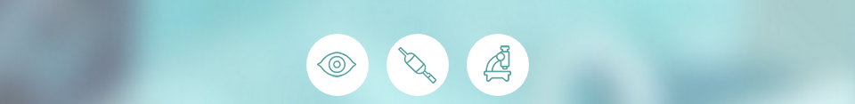
RADIOFREQUENCY ABLATION
IN BARRETT’S ESOPHAGUS

Slide 2
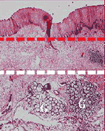

BarrxTM Ablation System
Technical background
Barrx TMFLEX generator delivers radiofrequency energy, resulting in uniform, controlled ablation (~500 microns deep), due to:
Automated RF energy delivery;
Fixed amount RF energy density;
Fixed power;
Bipolar electrode array.
Target mucosa
Ablation depth Muscularis mucosae

Slide 3
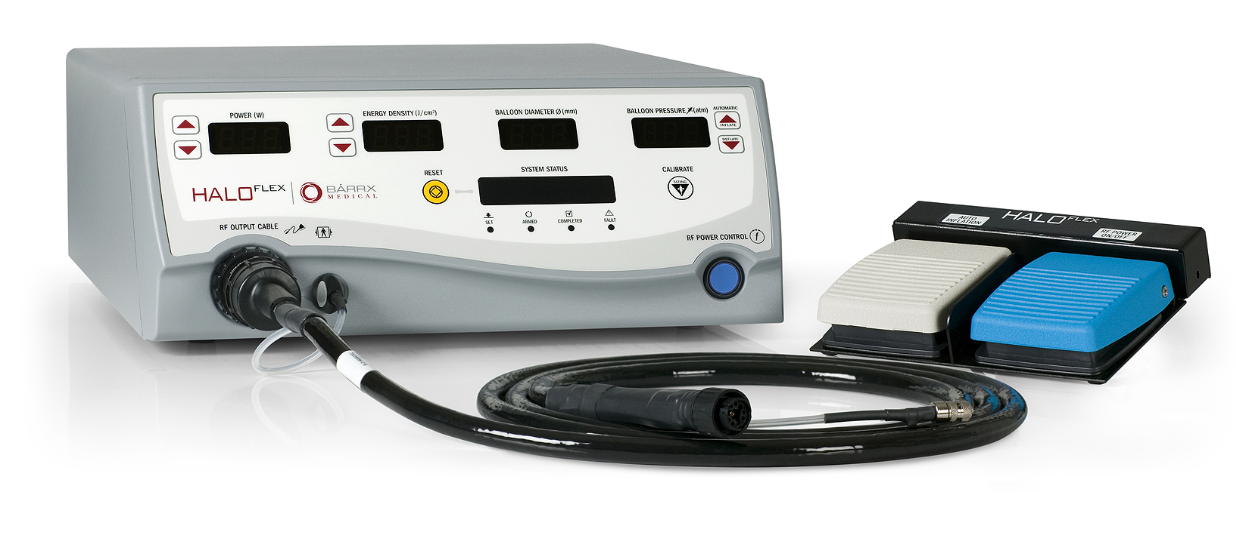
BarrxTM Ablation System
RFA Barrx TM FLEX generator
Buttons to adjust power (Watt)
Buttons to adjust energy (Joule/cm²)
Display for EID (mm)
Inflation pressure (psi)
Inflation/deflation buttons
Display for energy and power settings and for general instructions
Reset button
Cable to connect the catheter to the generator (air and RF energy)
Foot pedal to in/deflate balloon
Foot pedal to activate electrode

Slide 4
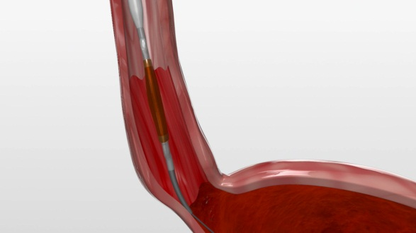
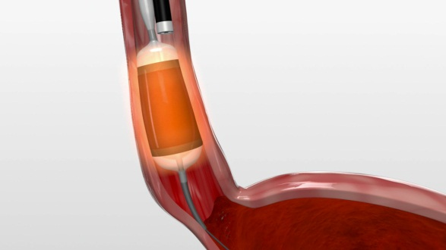
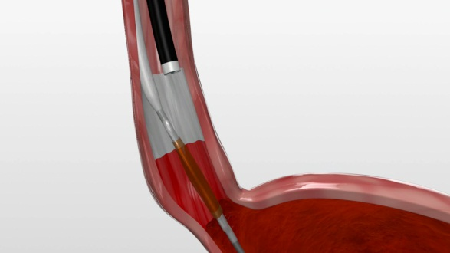
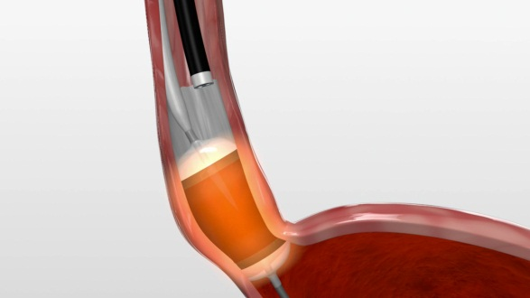
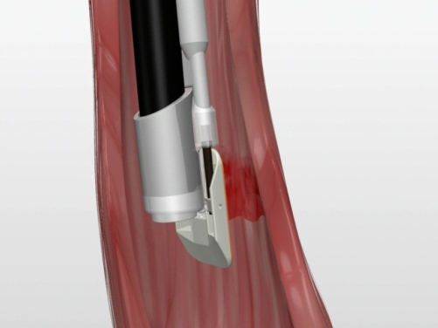
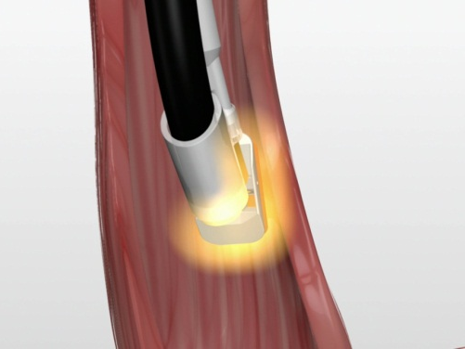
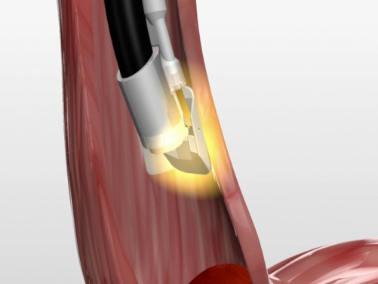
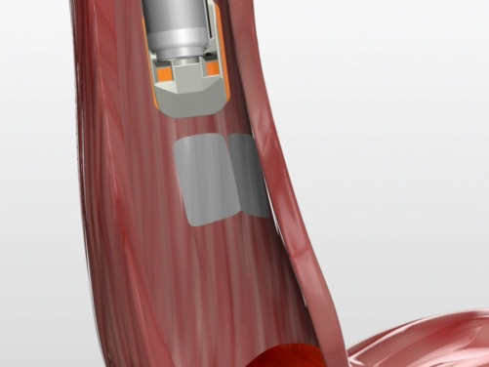
Barrett’s esophagus: circumferential and focal radiofrequency ablation

Slide 5
Circumferential radiofrequency ablation

Slide 6
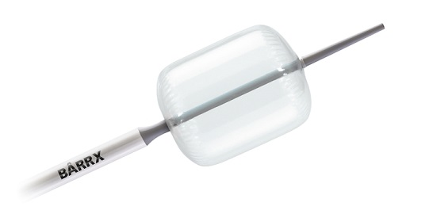
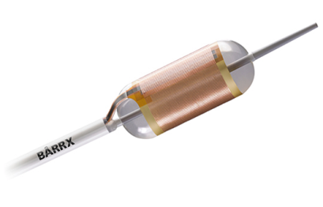
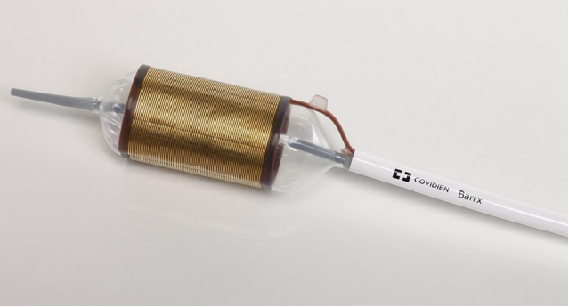
BarrxTM Ablation System
Circumferential devices
BarrxTM 360 system
Non-compliant 4cm long balloon catheter, for sizing of esophageal inner diameter.
Balloon catheter with a 360 degree electrode array over a length of 3 cm.
BarrxTM 360 Express
A 360 degree electrode array wrapped around a self-adjusting balloon over a length of 4 cm.

Slide 7
BarrxTM 360 system
using the standard ablation regimen
Step 1: size inner diameter of the esophagus
Step 2: choose appropriate size ablation catheter
Step 3: Ablation BE- clean off debris- second ablation BE

Slide 8
BarrxTM 360 system
using the standard ablation regimen
83% BE surface regression 3 months after treatment
Total procedure time: 39 minutes
Disadvantages
  Multiple introductions of the endoscope and catheters
  Ablation catheter with a fixed diameter for the entire BE segment
van Vilsteren et al. Clin Gastroenterol Hepatol 2013

Slide 9
BarrxTM 360 system
Fixed ablation catheter
Differences in esophageal diameter of the BE segment → zones with less contact between the electrode and the esophageal wall:
  Ablation catheter chosen based on the smallest diameter → may result in decreased efficacy
  Ablation catheter chosen based on the largest diameter
  → may increase the risk of adverse events

Slide 10
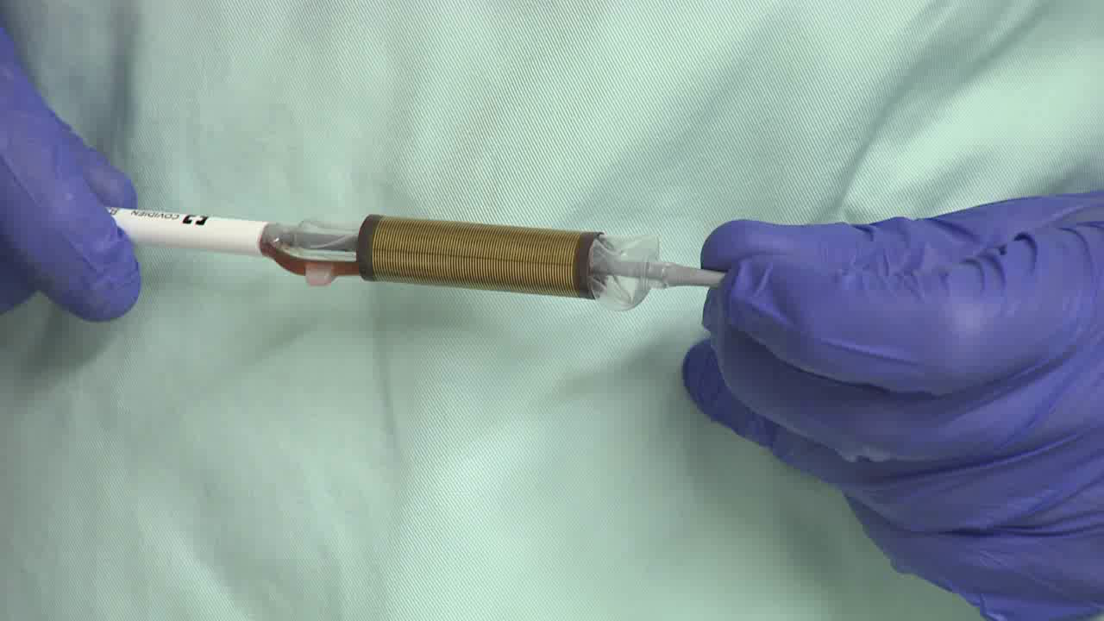
BarrxTM 360 Express
“Self-Sizing RFA balloon”
Theoretical advantages:
Will adjust to esophageal diameter → overcomes discrepancies in diameter in long Barrett’s
No need for separate sizing procedure: less introductions, shorter procedure time

Slide 11
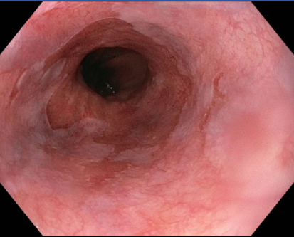
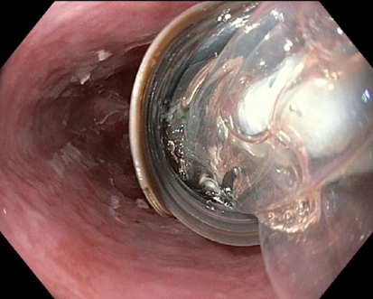
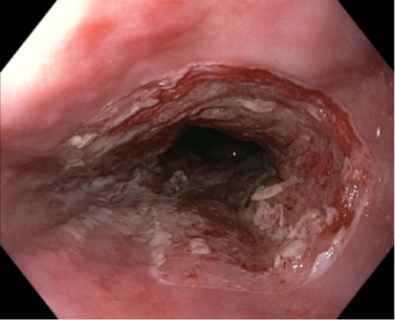
Dutch multicenter pilot study in 30 patients using the Express 360
Standard ablation regimen: 12J/cm² – clean – 12J/cm²

Slide 12
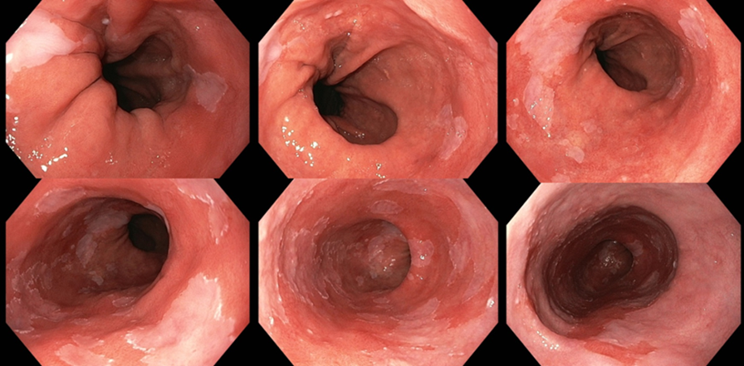
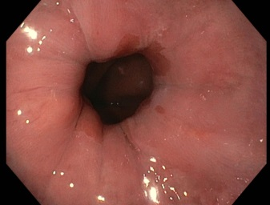
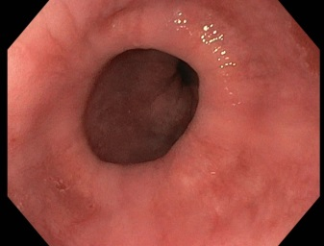
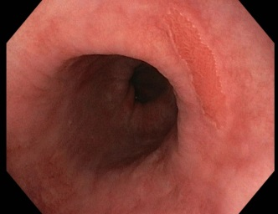
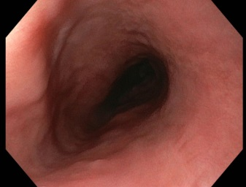
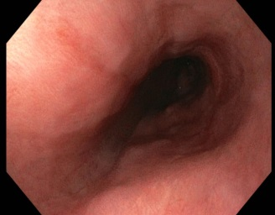
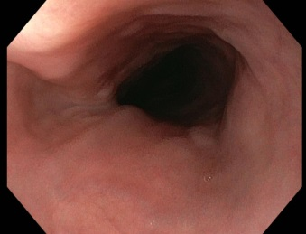
Dutch multicenter pilot study in 30 patients using the Express 360
Primary outcome: BE regression 3 mo after Express treatment
  Photos of every cm of BE segment before and after treatment
  Scored seperately by 2 endoscopists
  Mean score per patient
Pre-treatment: C8M10 BE
Post treatment: regression 95%

Slide 13
Outcomes multicenter pilot study
Median BE regression at 3 months: 90% (IQR 77-95)
Median procedure time: 31 minutes
Adverse events 360 Express procedure
  mucosal laceration (n=1)
  atrial fibrillation (n=1)
  vomiting and dysphagia without stricture (n=1)
  dysregulated diabetes (n=1)
In 7/30 (23%) esophageal scarring seen at 3 mo FU. However, no symptomatic strictures
Belghazi et al. GIE 2016;83:AB555

Slide 14
After subsequent focal RFA sessions
Complete eradication of dysplasia in 97%
Complete eradication of intestinal metaplasia in 87%
Symptomatic stenosis in 10% of patients, requiring median of 1 dilation sessions
Belghazi et al. GIE 2016;83:AB555

Slide 15
Conclusions pilot study Express 360
Circumferential RFA with the 360 Express using the standard ablation regimen (12J/cm² – clean – 12J/cm²⁾ is highly effective in eradicating BE with 90% regression after a single 360 Express procedure
However, concerns regarding the stenosis risk based on a
theoretically higher stenosis risk compared with the Barrx 360 system and esophageal scarring in 23% of patients after a single 360 Express procedure

Slide 16
Higher stenosis risk with 360 Express?
Barrx 360 system: ablation catheter is chosen based on the smallest measured esophageal diameter
Express 360: will self-adjust which results in optimal contact between the electrode and esophageal wall
More optimal contact with the Express ystem is inevitably associated with more energy being delivered to the Barrett’s segment that the traditional Barrx 360 system.

Slide 17
Lowering energy settings to 10J/cm²
For further studies we lowered the energy density settings from 12J/cm² to 10J/cm² because this may deliver a better balance of clinical efficacy and safety
Instructions for Use of Express 360 system: energy density settings: 10J/cm²

Slide 18
Optimal ablation regimen 360 Express?
Ongoing randomized trial:
  Standard regimen: 1x 10J/cm² – clean – 1x 10J/cm²
  Simple-double regimen: 2x 10J/cm² – no clean
  Simple-single regimen: 1x 10J/cm² – no clean

Slide 19
Early closure simple-double ablation arm
Interim results showed severe strictures in 17% in the simple-double ablation arm
Based on these findings and after consultation with the Data Safety Monitoring Board the simple-double was closed
Study is currently still ongoing with the standard and simple-single arm
Pouw et al. Gastroenterology 2017;153:164

Slide 20
Optimal ablation regimen 360 Express?
Stick to the standard ablation regimen (1x10J/cm² – clean – 1x10J/cm²)

Slide 21
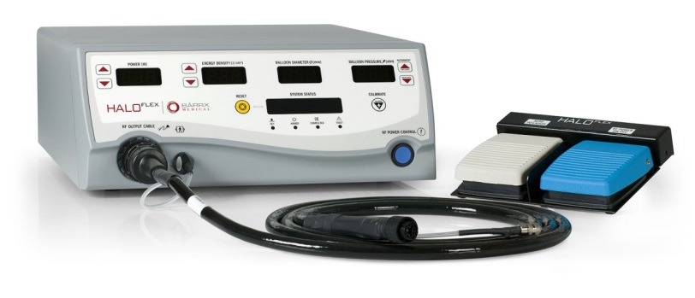
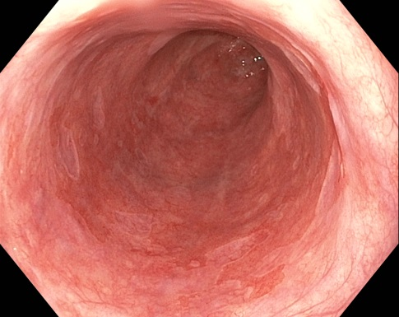
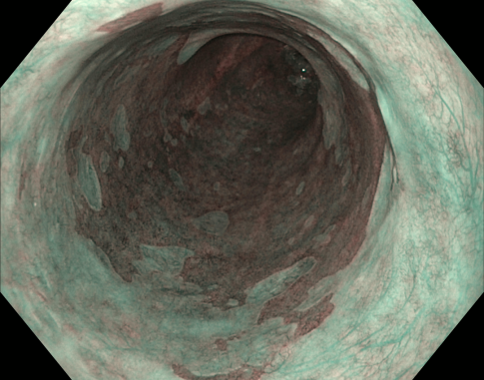
360 Express using the standard ablation regimen
Step 1: check settings
Energy density at 10J/cm²
Step 2: Clean esophageal wall by flushing with water

Slide 22
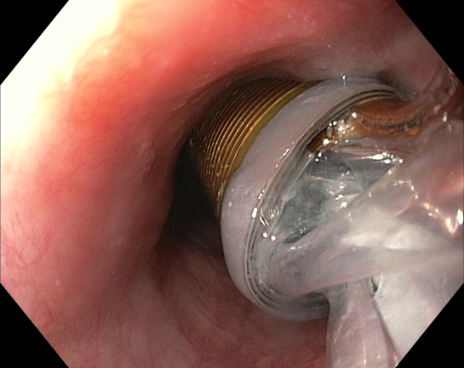
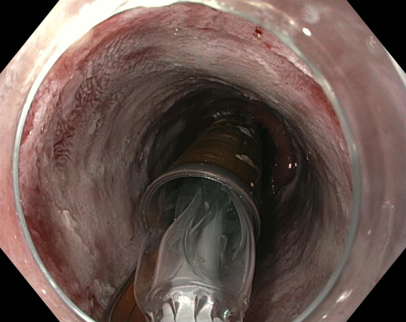
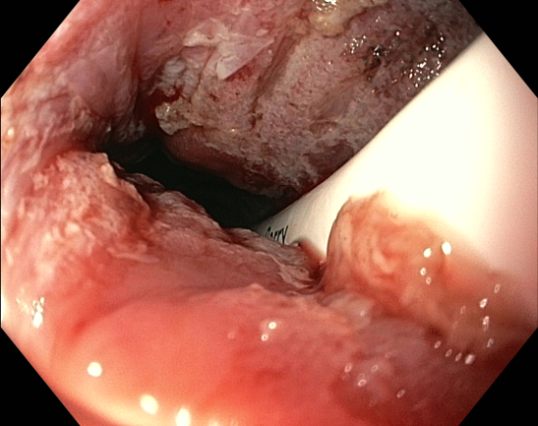
360 Express using the standard ablation regimen
Step 3: First ablation at 10J/cm²
  Introduce the 360 Express
  Position the electrode under direct visualization so that its proximal edge is
  +/- 1cm proximal to the BE segment
  Depress the left foot pedal: the balloon will inflate and the electrode will unfurl until it contacts the esophageal wall.
  Apply suction via the endoscope and depress the right foot pedal: energy will be delivered.
  After energy delivery, the balloon catheter will automatically be deflated
  Repeat step B – E until the entire BE segment is ablated (distal end treatment zone overlaps with GF) using visual repositioning.
  A small overlap (i.e. <1cm) between ablation zones is allowed. Be careful significant overlap may cause stenosis

Slide 23
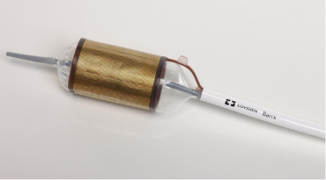
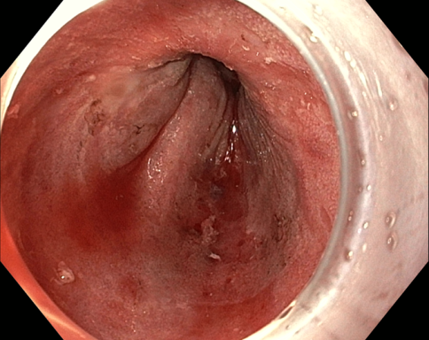
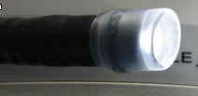
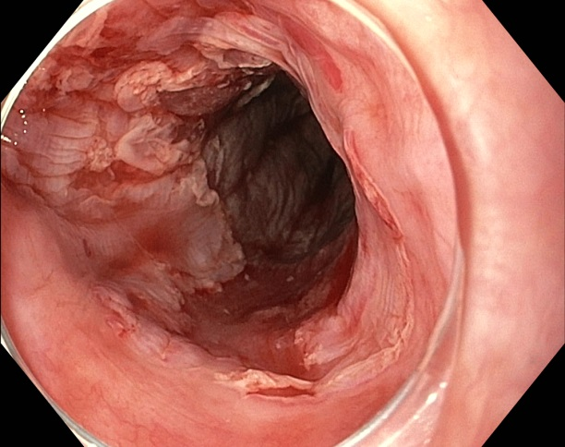
360 Express using the standard ablation regimen
Step 4: Cleaning phase
  Remove endoscope and 360 express
  Clean debris from the catheter
  Reintroduce the endoscope with a distal attachment cap and gently wipe of the debris from the ablation zone
Step 5: Second ablation at 10J/cm²
  Repeat step 3

Slide 24
Focal radiofrequency ablation

Slide 25
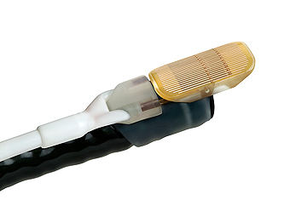
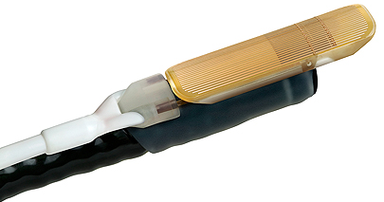
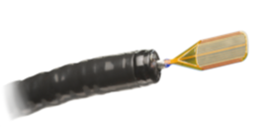
BarrxTM Ablation System
Focal devices
BarrxTM 90 focal catheter
BarrxTM ultra long focal catheter
BarrxTM 60 focal catheter
BarrxTM channel RFA endoscopic catheter

Slide 26
Indications BarrxTM 90
The BarrxTM90 device is usually used for secondary RFA of residual BE mucosa after initial circumferential ablation
However, the BarrxTM90 system may also be used for primary RFA.
Indications for BarrxTM90 ablation:
Circumferential BE <2 cm;
Circular treatment Z-line (at least once);
Small tongues;
Diffuse islands.

Slide 27
Optimal ablation regimen for BarrxTM 90?
US versus Europe
In the US, the standard regime is 2x12J/cm² -clean-2x12J/cm²
Based on the regime used in the AIM-Dysplasia study.
In Europe, the standard regime is 2x15J/cm² -clean-2x15J/cm² Based on dose escalation studies that extended after the AIM Dysplasia study in the US was initiated. Regimen used in all European studies.
As a results: different focal ablation regimes in US and Europe.
Van Vilsteren GIE 2013; Künzli Endoscopy 2015

Slide 28
Optimal ablation regimen for BarrxTM 90?
A European RCT suggested that a simplified regimen (3x15J/cm² -no clean) is equally effective as the standard (2x15J/cm² -clean-2x15J/cm²).
Advantages of the simplified regimen include less introductions of the endoscope and shorter procedure time.
Unfortunately, this 3x15J/cm² -no clean regimen was associated with a higher stricture rate.
Therefore we lowered the energy density settings and compared a new simplified regimen to the standard regimen
Van Vilsteren GIE 2013; Künzli Endoscopy 2015

Slide 29
Optimal ablation regimen for BarrxTM 90?
Randomized trial comparing:
  Standard regimen: 2x 15J/cm² – clean – 2x 15J/cm²
  Simplified regimen: 3x 12J/cm² -no clean

Slide 30
Conclusions RCT
The simplified regimen (3x12J/cm²-no clean) is non-inferior to the standard regimen (2x15J/cm²-clean-2x15J/cm²) when comparing efficacy
The simplified regimen is associated with a significantly shorter procedure time, making it favorable to use.
Pouw et al. GIE 2017;85:AB122

Slide 31
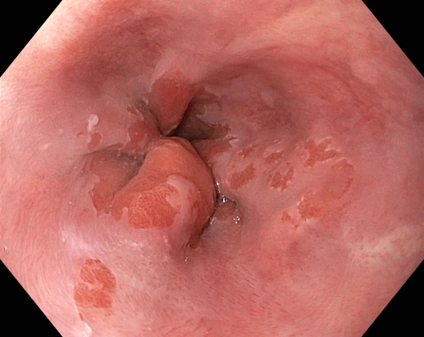
BarrxTM 90 using the simplified regimen
Step 1: check settings
Energy density at 12J/cm²
Step 2: Clean esophageal wall by flushing with water

Slide 32
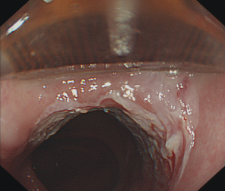
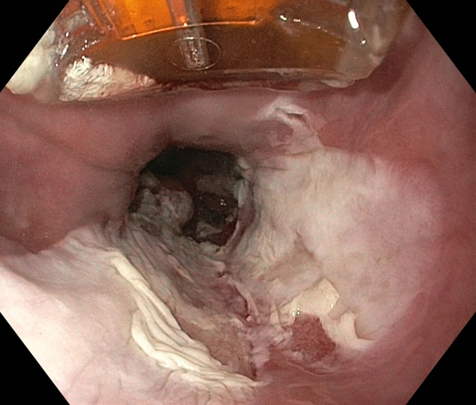
BarrxTM 90 using the simplified regimen
Step 3: Ablation residual BE
  Introduce BarrxTM90 catheter
  Position the target areas of BE at the 12 o’clock position
  Bring the electrode into contact with the esophageal wall, and angulate the endoscope upwards to improve contact between the electrode and the mucosa;
  the cap should tilt down in the endoscopic field as on the right
  Ablate 3 times in a row without cleaning in between
  Repeat step b – e until all Barrett’s tissue is ablated

Slide 33
Ablation z-line
When the BarrxTM90 electrode is introduced to ablate residual islands or tongues of BE mucosa, circumferential ablation of area at the upper end of the gastric folds is recommended, because:
  Contact BarrxTM360 balloon here is generally suboptimal
  Endoscopic inspection unreliable for presence of residual BE in this area
  Sampling error of random biopsies in this area
  This is the area where most recurrences occur.

Slide 34
Circumferential ablation of the Z-line is challenging
  Ensure that the Z-line is straddled by the Barrx90TM catheter
  Ablate adjacent zones while keeping the endoscope at the same insertion depth
  Turn the endoscope step-by-step to circumferentially ablate the Z-line.

Slide 35
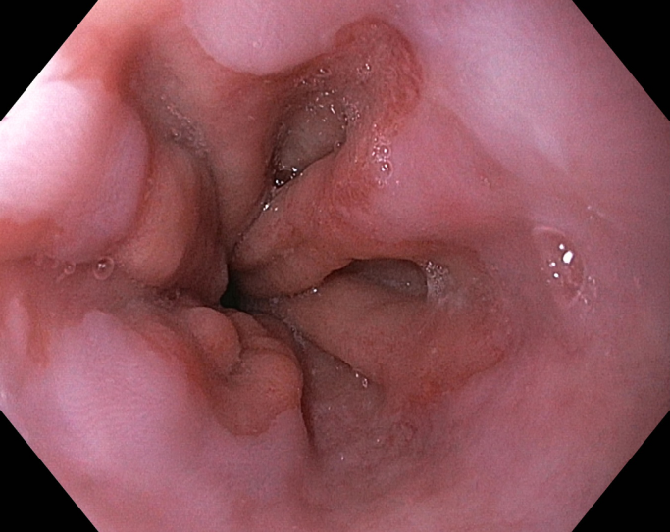
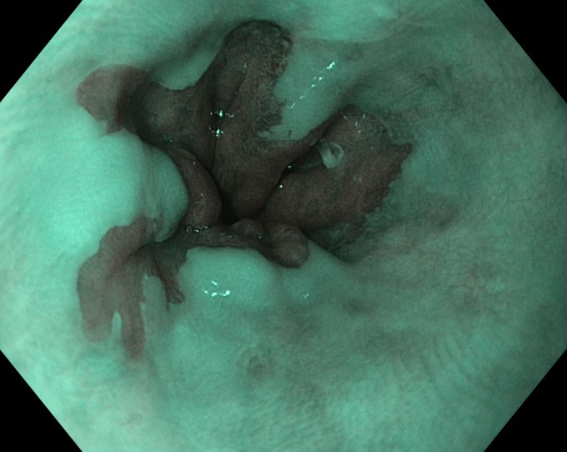
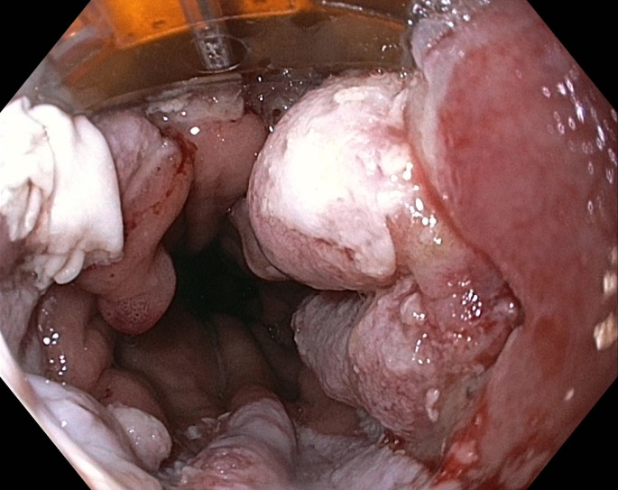
Circumferential ablation of the Z-line

Slide 36
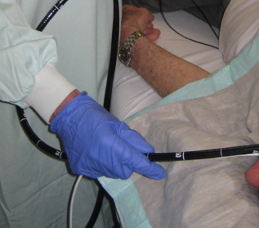
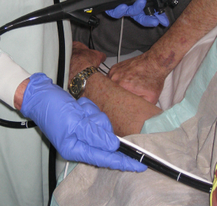
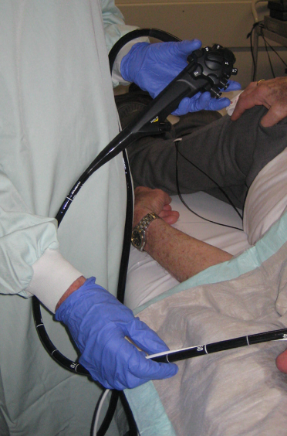
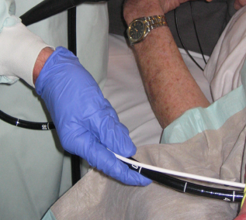
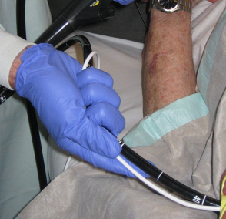
Circumferential ablation of the Z-line
1
2
3
4
0

Slide 37
Indications for other focal devices: limited data availabe, selective use advised
BarrxTM ultra long focal catheter
200% surface BarrxTM90
Large tongues
Short segment BE
60% surface BarrxTM90
Small islands in the presence of a stenosis
Through the working channel
BarrxTM 60 focal catheter
BarrxTM channel RFA endoscopic catheter

Slide 38
RFA in clinical practice

Slide 39
Indications for radiofrequency in Barrett’s esophagus
Residual Barrett’s after ER for cancer or HGD
    (i.e. after removal of visible lesions)
Flat type high-grade dysplasia (HGD)
    (i.e. no visible lesions)
Flat type low-grade dysplasia (LGD)
    (i.e. no visible lesions)

Slide 40
Ground rules for Barrett’s ablation
Don’t ablate visible lesions!
“Don’t use ablation as a poor excuse not to perform endoscopic resection…”
You need to be proficient in ER if you do ablation
“You can only resect what you detect”

Slide 41
Ground rules for Barrett’s ablation
Wait for the mucosa to heal
High-quality imaging
in all
Endoscopic resection
in most
Endoscopic ablation
in some

Slide 42
Ground rules for Barrett’s ablation
Wait for the mucosa to heal
After an endoscopic resection (ER):
  Wait for at least 6 weeks (we do 3 months) to be sure that the ER-site has healed and the residual Barrett’s is flat
  If you come back too soon, you will be confused. You cannot distinguish regenerative changes at the borders of an incompletely healed ER site from a visible neoplastic lesion.
  Biopsies will then not help: your pathologist will be confused by reactive changes and any residual dysplasia.

Slide 43
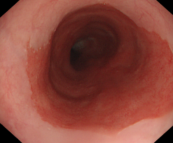





Ground rules for Barrett’s ablation
Wait for the mucosa to heal
  Wait for 3 months after every ablation session.
  The mucosa should be healed and flat, no exsudates or swelling.

Slide 44
Ground rules for Barrett’s ablation
Wait for the mucosa to heal
  Wait for 3 months after every ablation session.
  The mucosa should be healed and flat, no exsudates or swelling.
  Do NOT ablate if not completely healed!
    The mucosa is too thick for effective ablation.
    You will miss visible lesions (and this may last for months in a row if you repeat this ablate-not heal-ablate cycle).
    If necessary: postpone another 6 weeks.
  Do NOT biopsy: your pathologist will be confused by reactive changes and any residual dysplasia.
  Be patient: wait for the mucosa to heal.

