Slide 1
Histopathology and handling of EMR specimens
S.L. Meijer
Academic Medical Center, Amsterdam

Slide 2

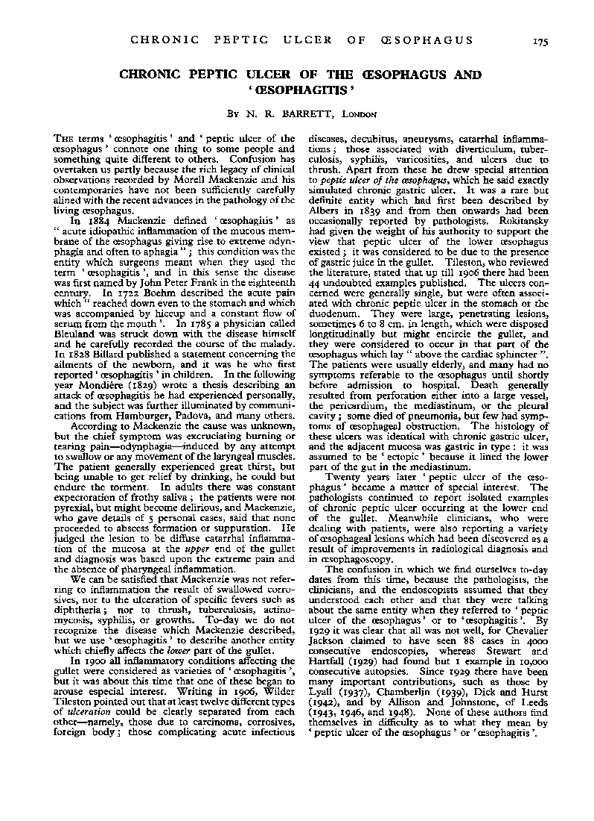
How it all started
Br J Surg 38 Oct. 1950

Slide 3
Definition of Barrett’s esophagus
A change in the esophageal epithelium of any length that can be recognized at endoscopy and is confirmed to have columnar epithelium / intestinal metaplasia by biopsy
Practice Parameters Committee of American College of Gastroenterology, Am J Gastroenterol 1998;93:1028-31 British Society of Gastroenterology (BSG), Gut 2006;55:44

Slide 4
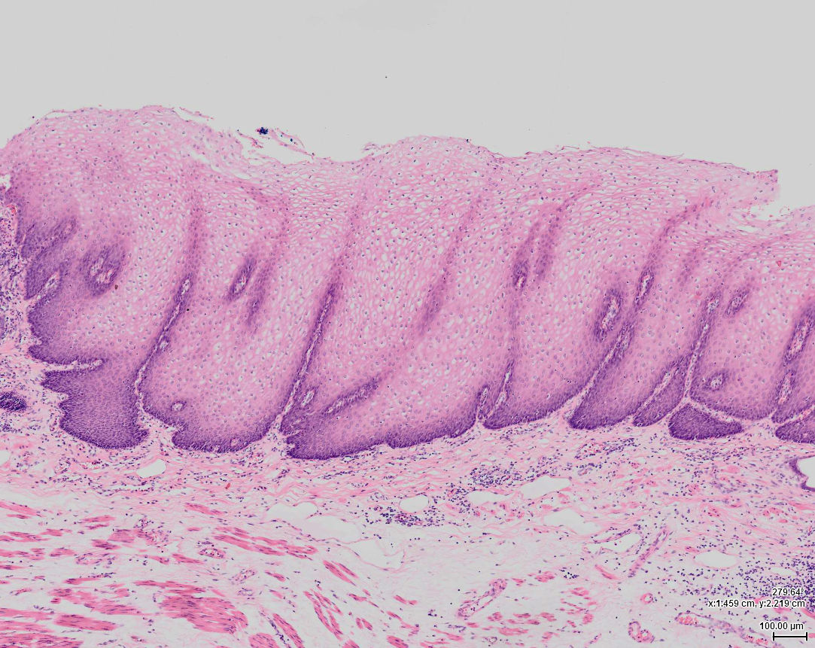
Squamous epithelium lining the esophagus

Slide 5
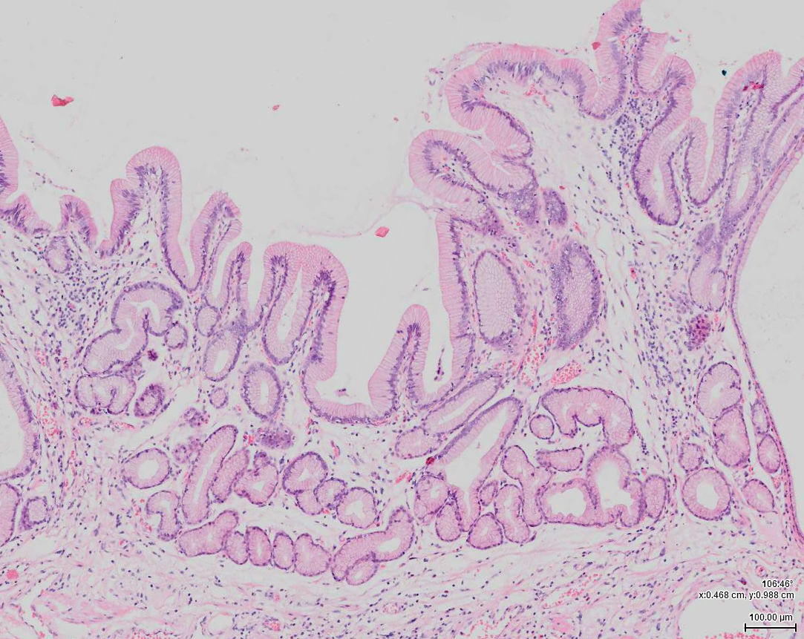
Due to reflux, normal esophageal (squamous) epithelium is replaced by gastric mucosa (metaplasia)

Slide 6
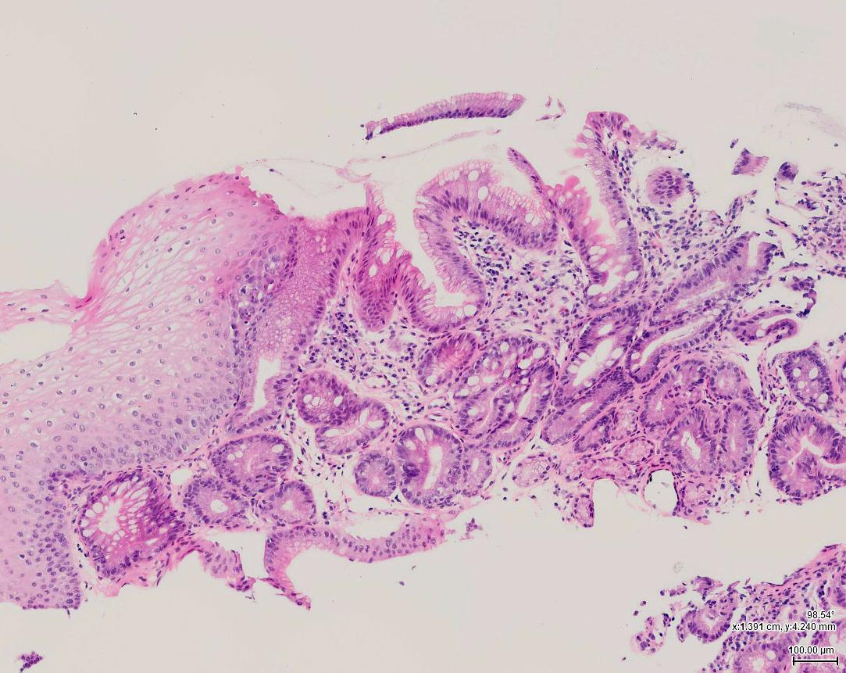
Non-dysplastic Barrett’s esophagus
Normal preexisting squamous epithelium
Squamo-columnar junction
Intestinal metaplasia (goblet cells)
Gastric type mucosa

Slide 7
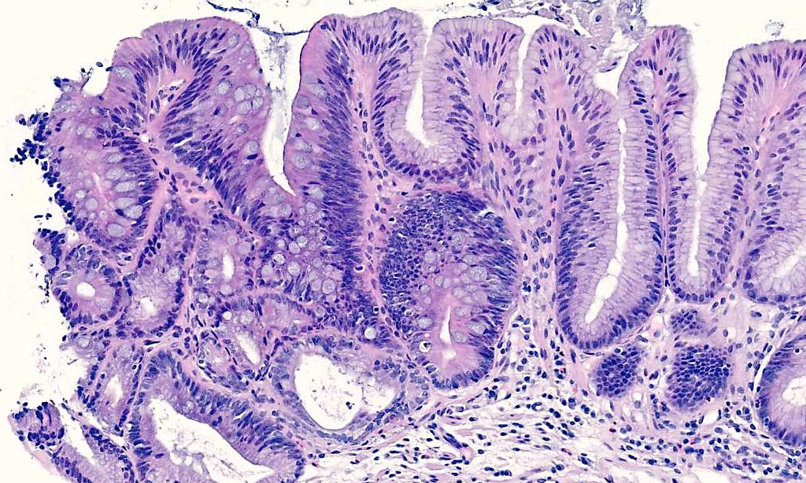
A small proportion of patients with Barrett’s esophagus develop neoplastic changes
Sharp demarcation
Metaplastic epithelium
Low-grade dysplasia

Slide 8
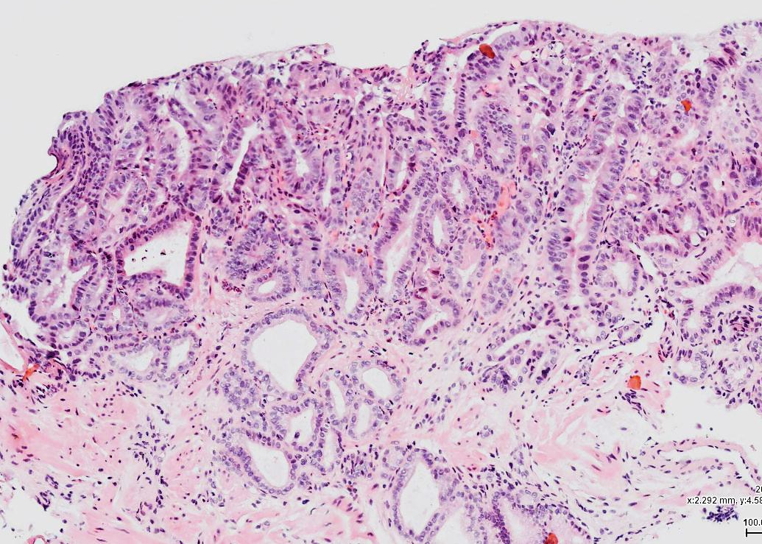
High grade dysplastic epithelium / early cancer

Slide 9
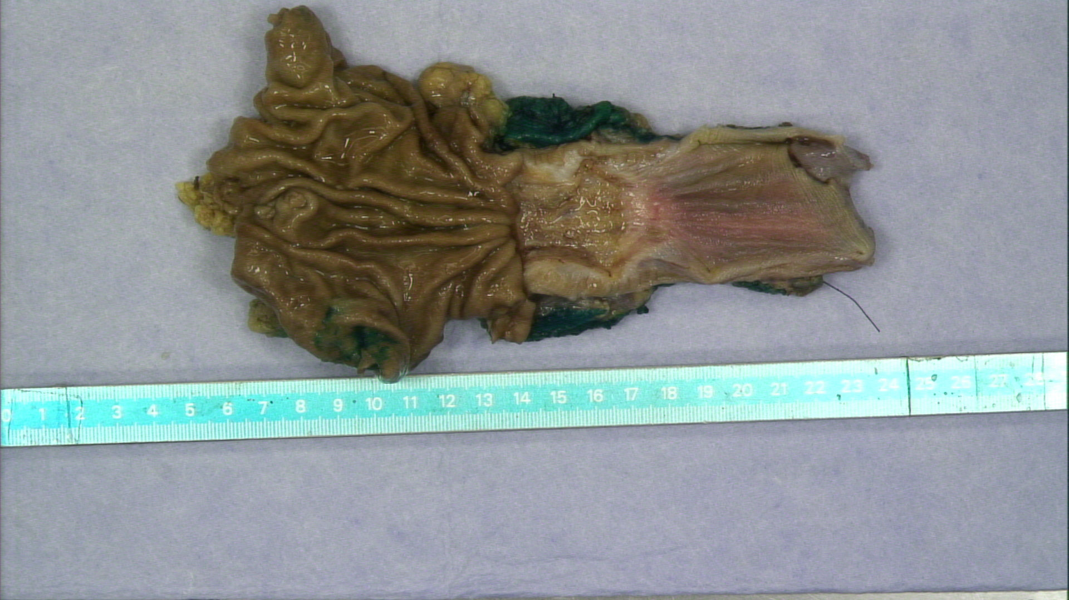
Resection specimen

Slide 10
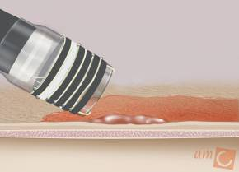
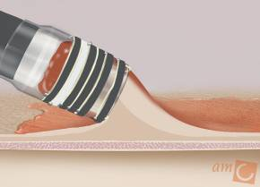
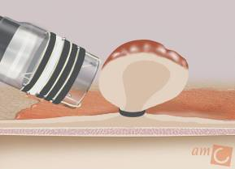
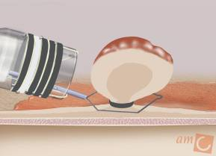
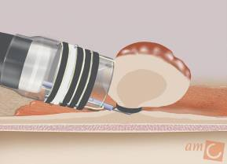
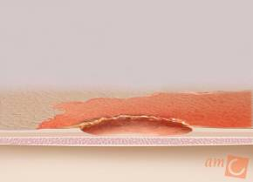
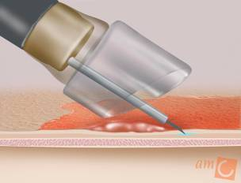
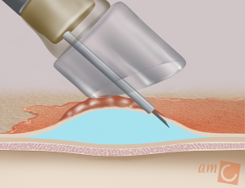
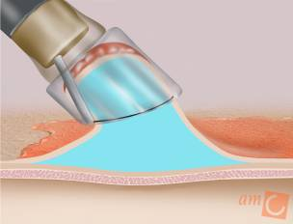
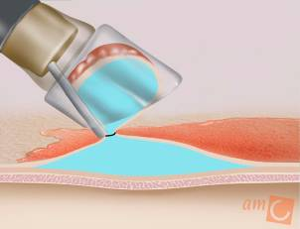
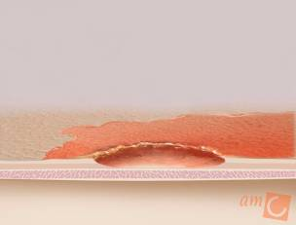
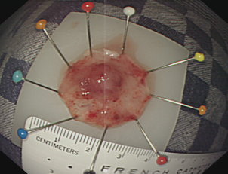
Endoscopic treatment techniques
Multiband mucosectomy (MBM)
ligate-and-cut
ER-cap technique
lift-suck-and-cut

Slide 11
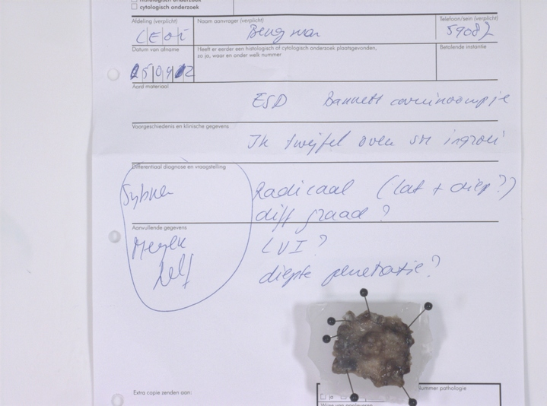
Endoscopist should loosely pin down specimen on paraffin block or cork to prevent from curling up (creates artefact)
Deliver up-side-down (specimen down) in formalin and fixate overnight

Slide 12
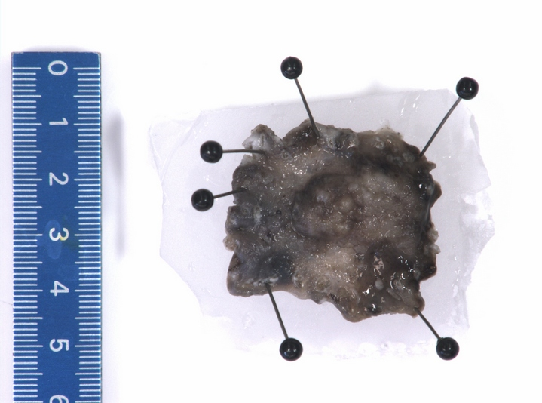
Usually non-marked specimen, photograph, mark basal resection margin

Slide 13
Slices, each 2 to 3 mm
1
2
3
4
5
6
7
8
9
10

Slide 14
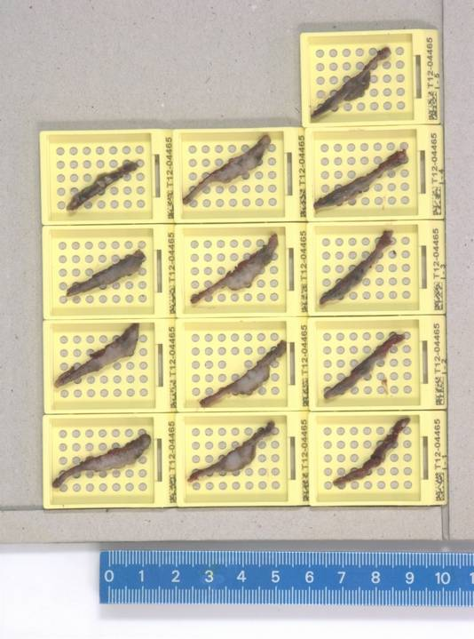
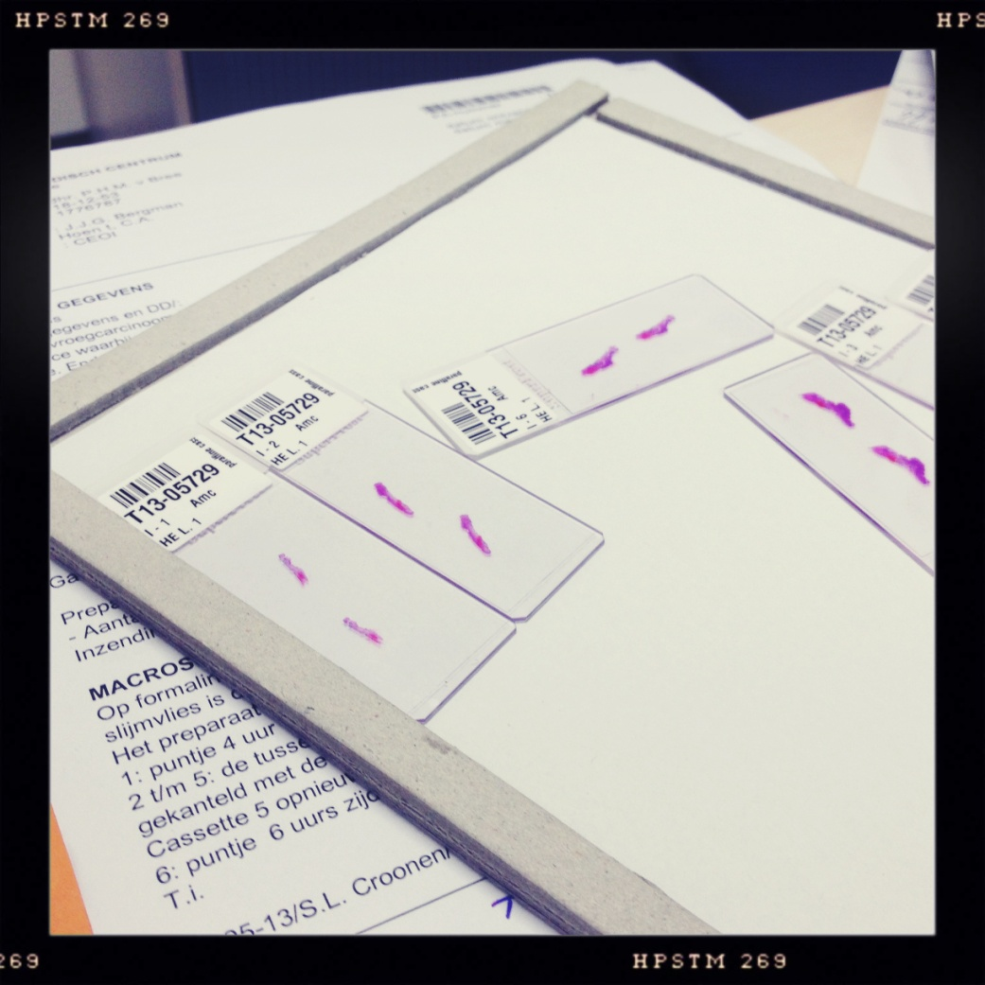
2 (to 3) slices per casette
2 (to 3) sections per slice

Slide 15
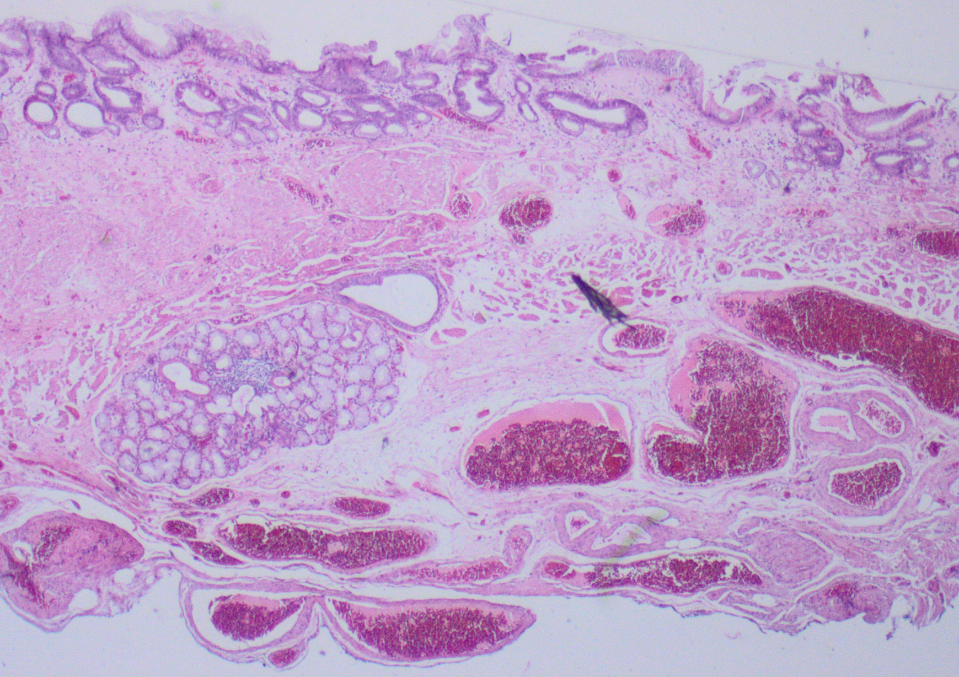
EMR specimen
epithelium
mucosa
lamina propria
musc. mucosa
submucosa
musc. propria

Slide 16
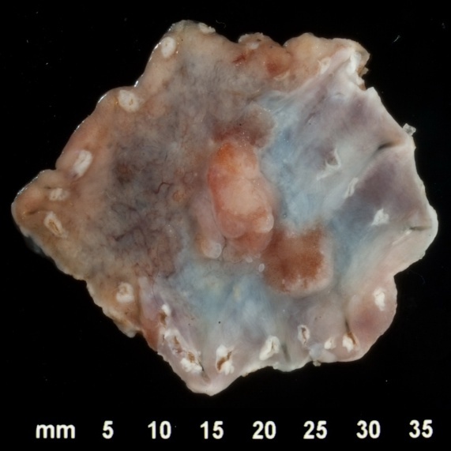
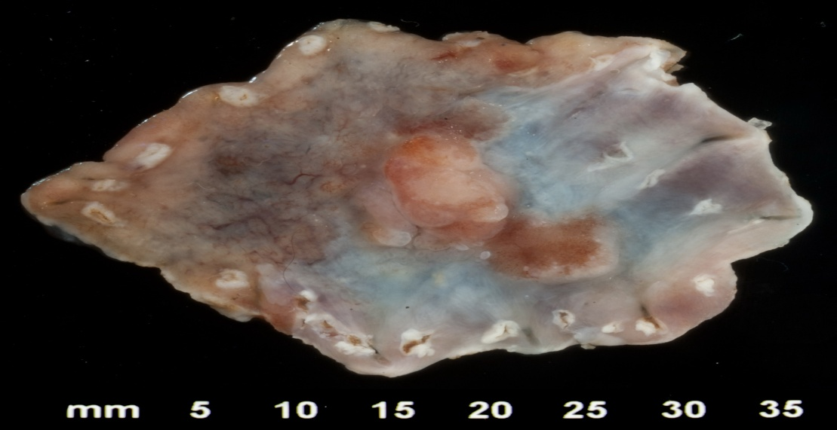
EMR specimen

Slide 17
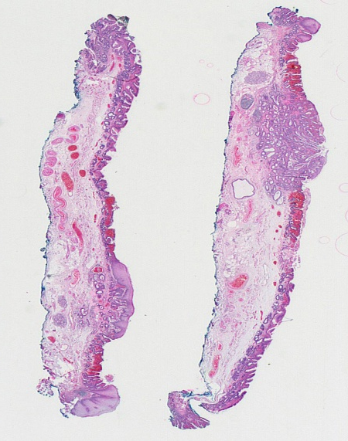
EMR specimen

Slide 18
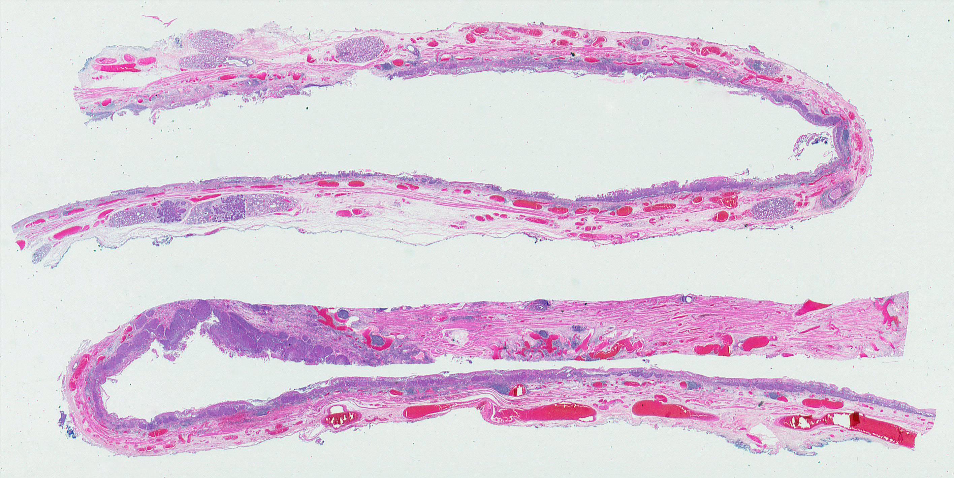
EMR specimen
z

Slide 19
Resection specimen

Slide 20
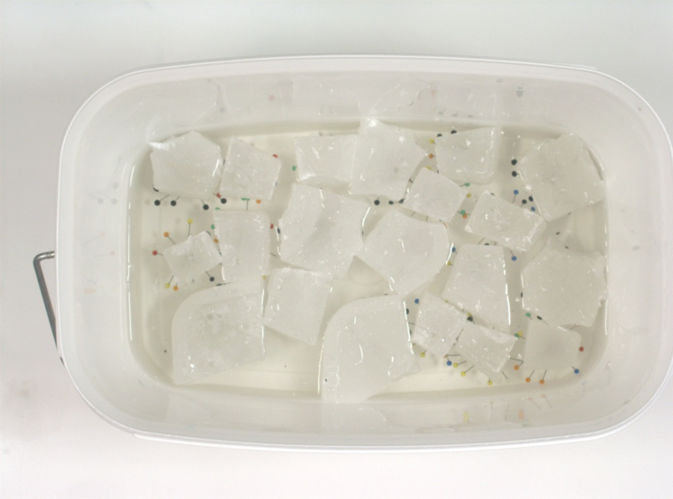
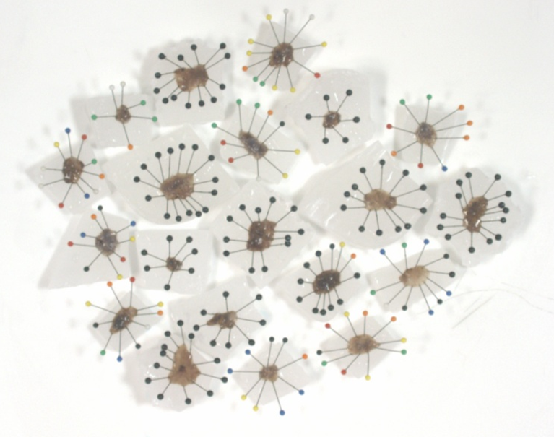
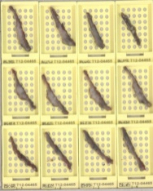
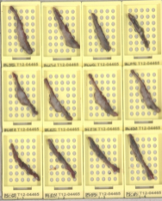
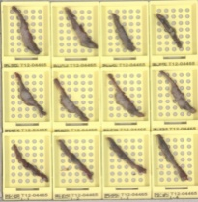
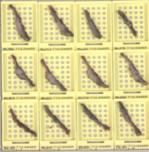
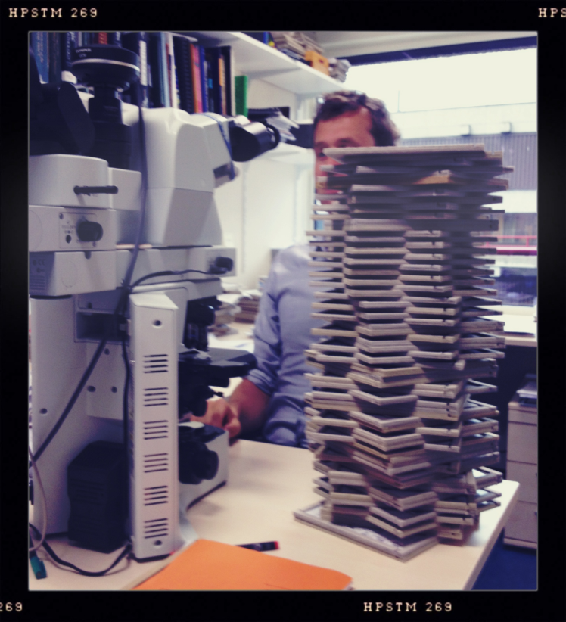


Slide 21
Conclusion EMR
Dysplasia / carcinoma / type
Differentiation grade
Depth of invasion
Submucosal invasion
Vaso invasion
Vertical margin (mm) / radicality
Lateral margin (not in piecemeal resection)
Intestinal metaplasia

Slide 22
Risk factors
Essential in sign out, relative risk factors for esophagectomy
Positive basal resection margin
Invasion in submucosa
Poorly differentiation grade (solid tumor, signet cell carcinoma)
Vaso invasive growth

Slide 23
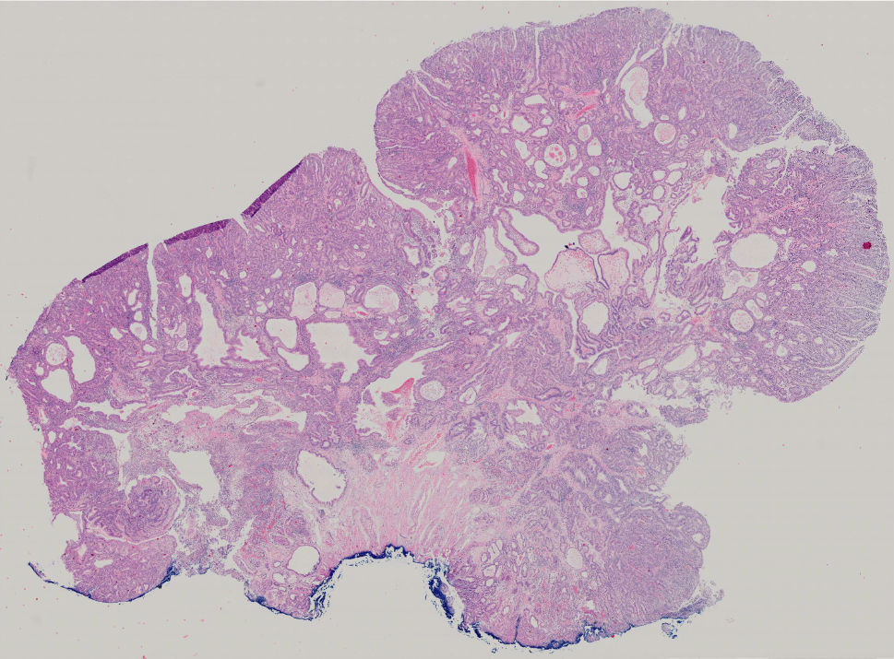
Risk factor: polypoid lesion with positive basal resection margin

Slide 24
Risk factor: uncertain basal resection margin

Slide 25
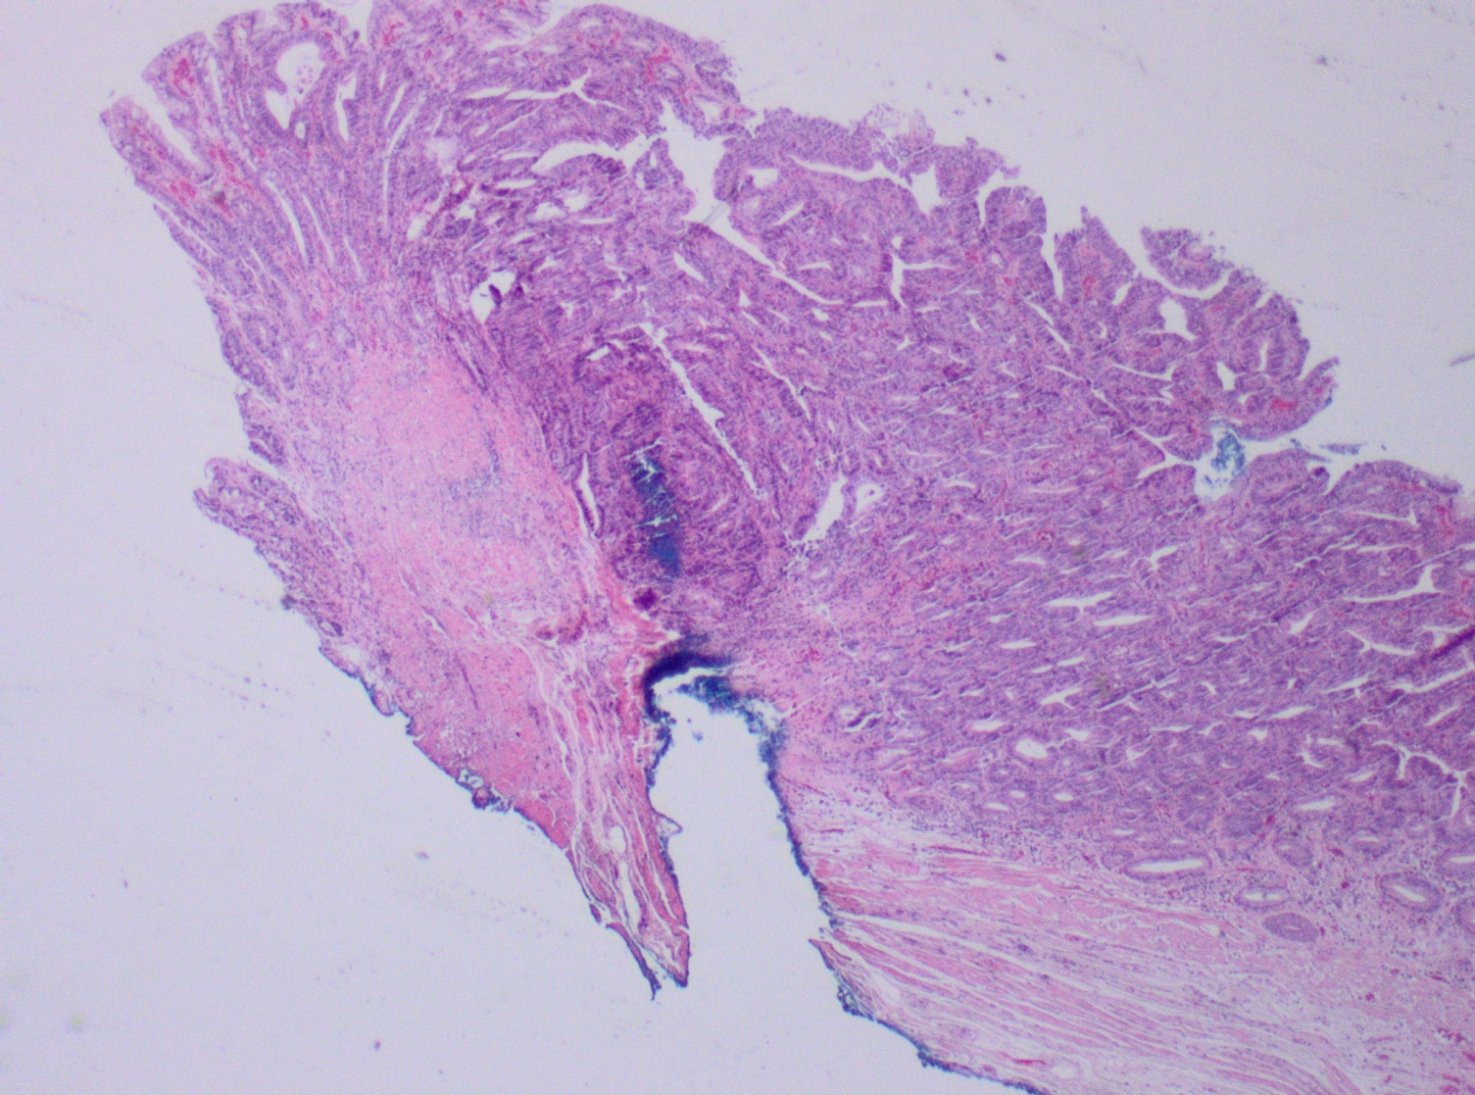
Risk factor: basal resection margin, needle artefact

Slide 26
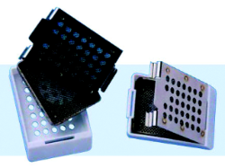


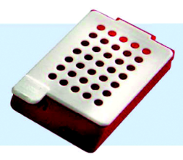
Alternative methods

Slide 27
Risk factor: Infiltration depth
Intramucosal disease
  high grade dysplasia
  intramucosal carcinoma confined to lamina propria
  intramucosal carcinoma invasion in musc. Mucosa (duplicated or original)
Submucosal disease
  Increase in invasion depth increase in chance of lymph node metastasis

Slide 28
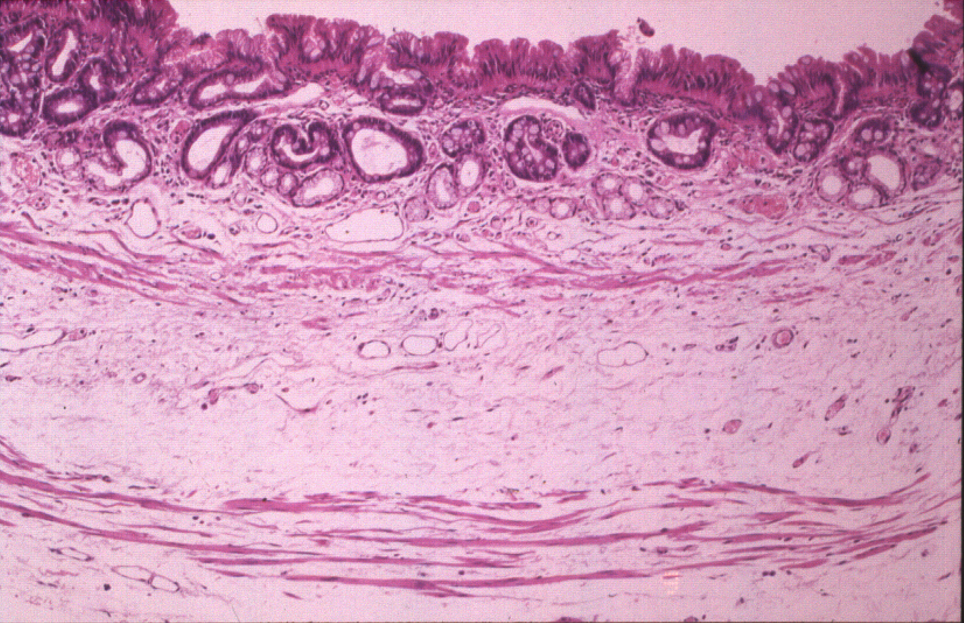
Classification of mucosal disease
Westerterp et al.
Vieth et al.
Kaneshiro et al.
HGD/m1
HGD
HGD
m1
LP
m2
IMM
m2
m3
BMM
m3
m4
OMM
Sm-1
Sm-1
Sm-1

Slide 29
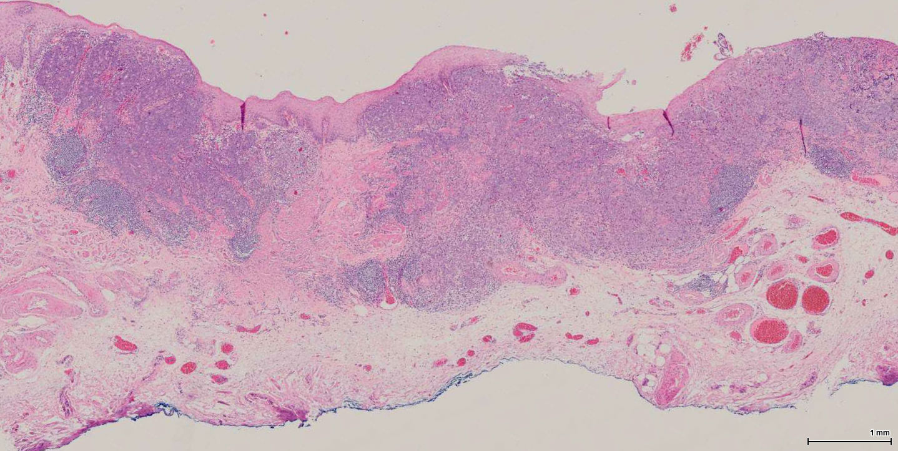
Risk factor: submucosal infiltration
Submucosal vessels

Slide 30
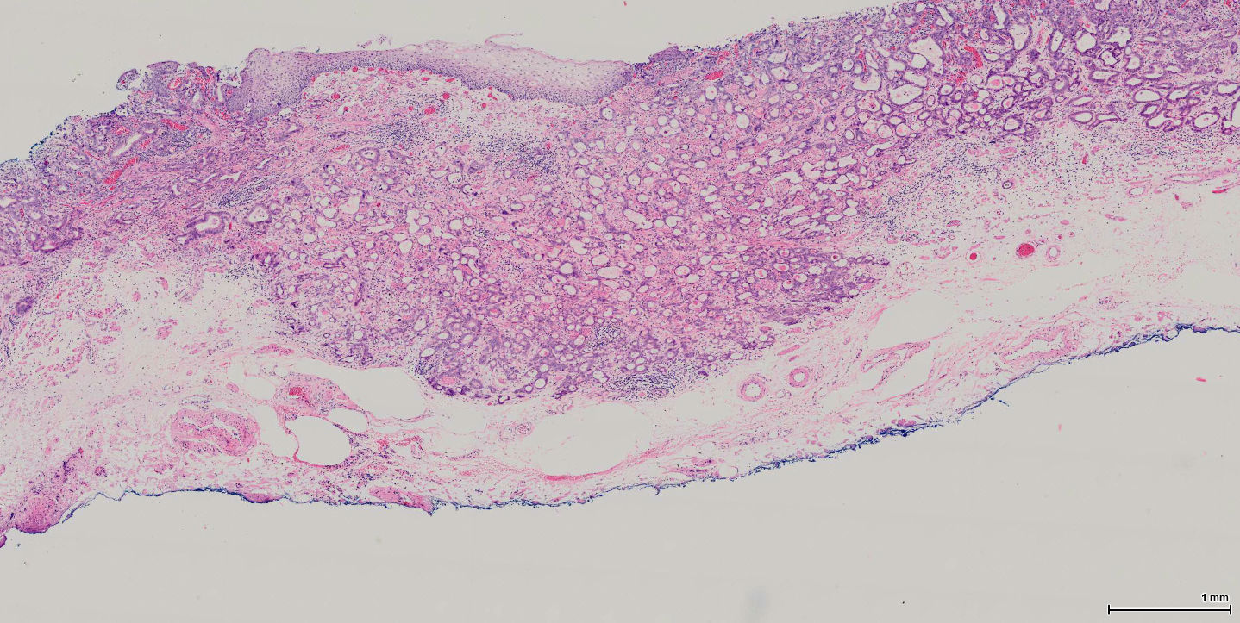
Risk factor: submucosal infiltration
muscularis mucosa
Submucosal vessels

Slide 31
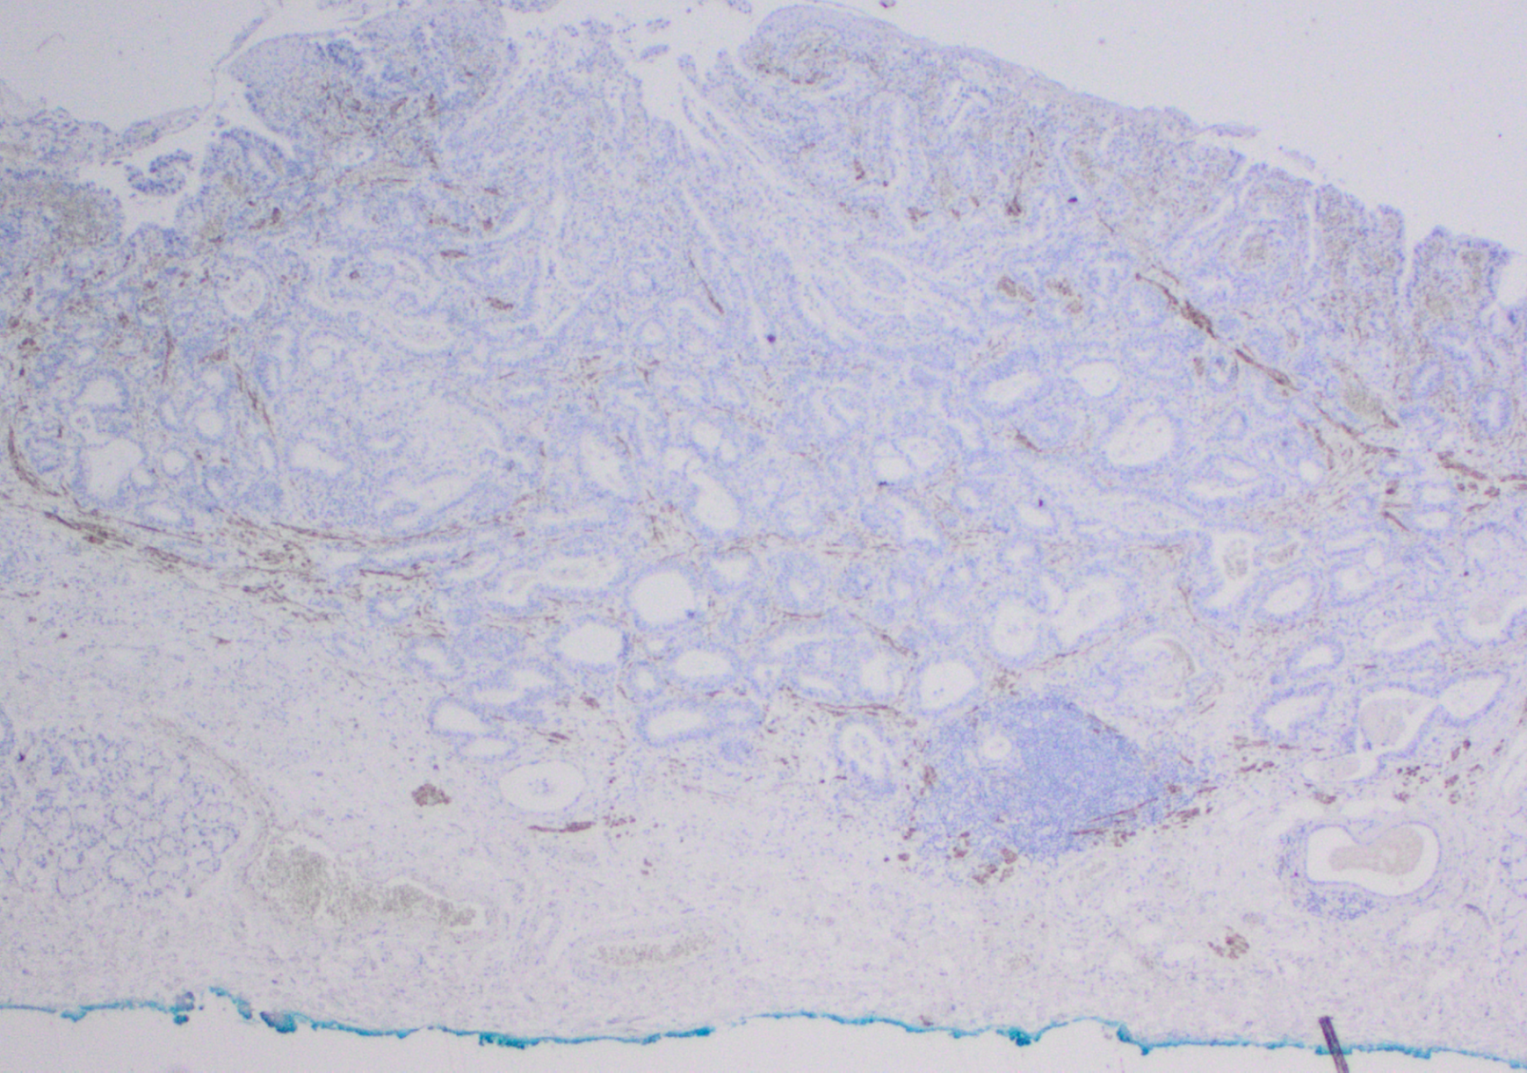
Desmin

Slide 32
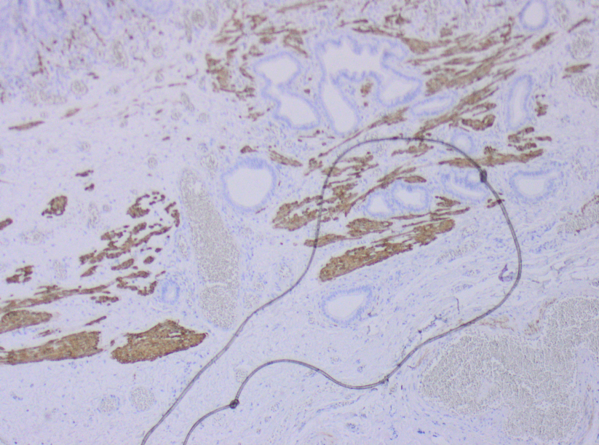
Submucosal infiltration depth is measured from (original) m. muc

Slide 33
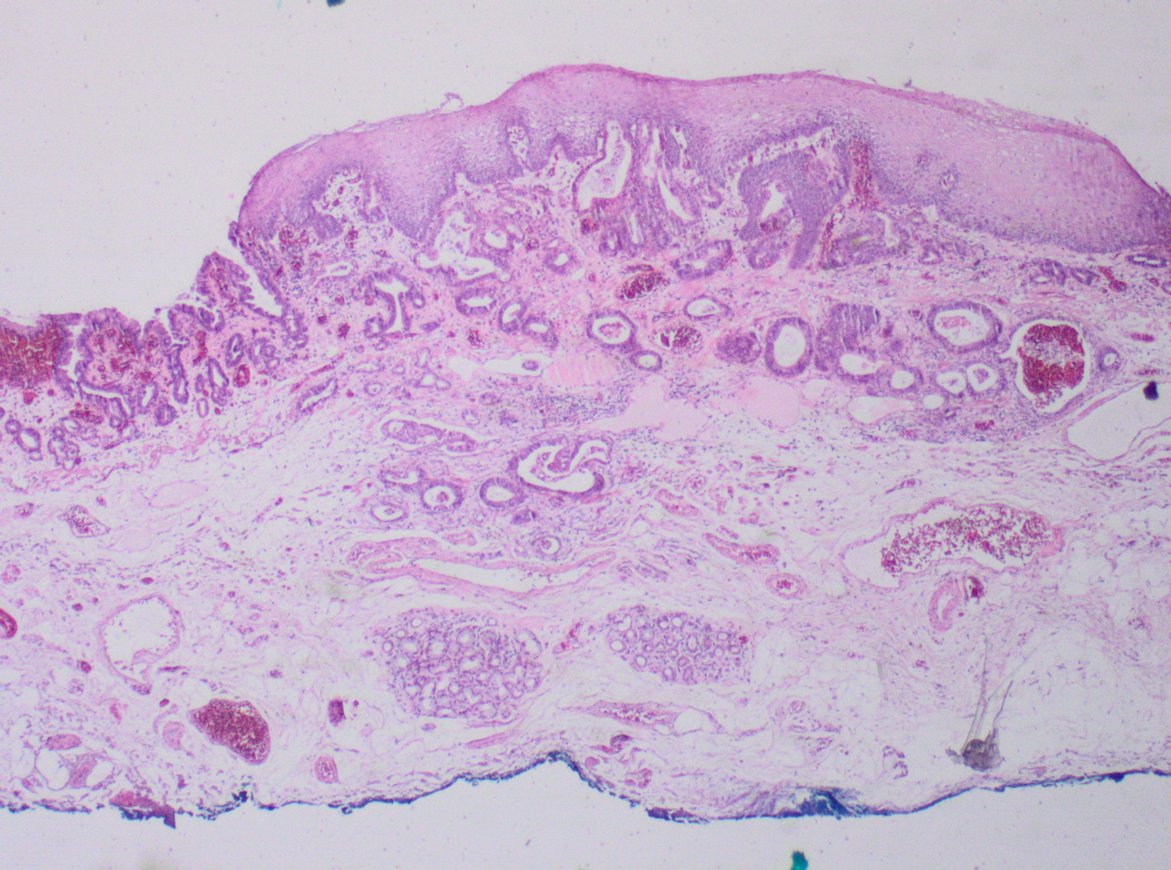
Risk factor: submucosal infiltration
sm1
500μm
200μm
upper
sm2
1000μm
500μm
middle
sm3
>1000μm
>500μm
lower

Slide 34
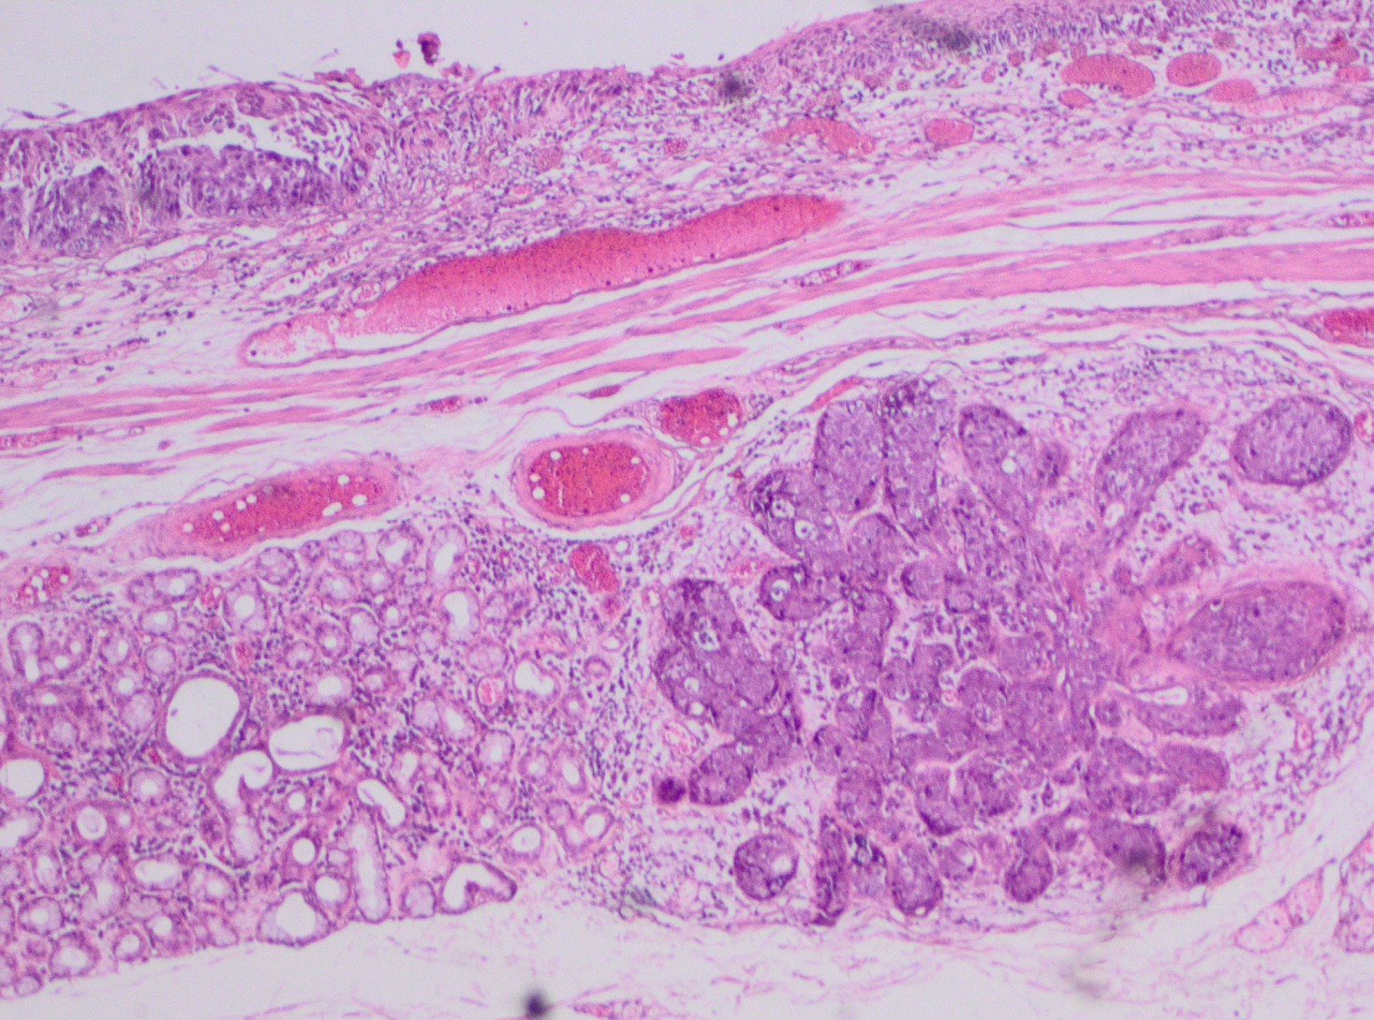
Pitfall of extensive esophageal gland involvement in squamous lesions

Slide 35
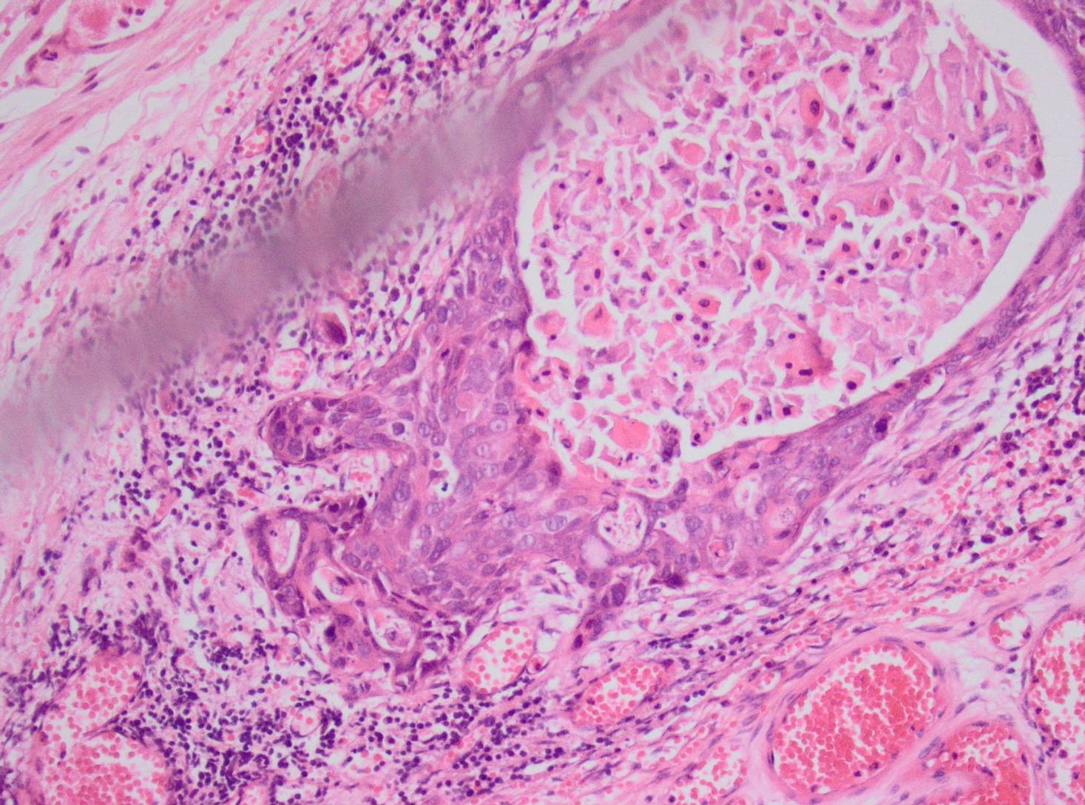
Submucosal invasion

Slide 36
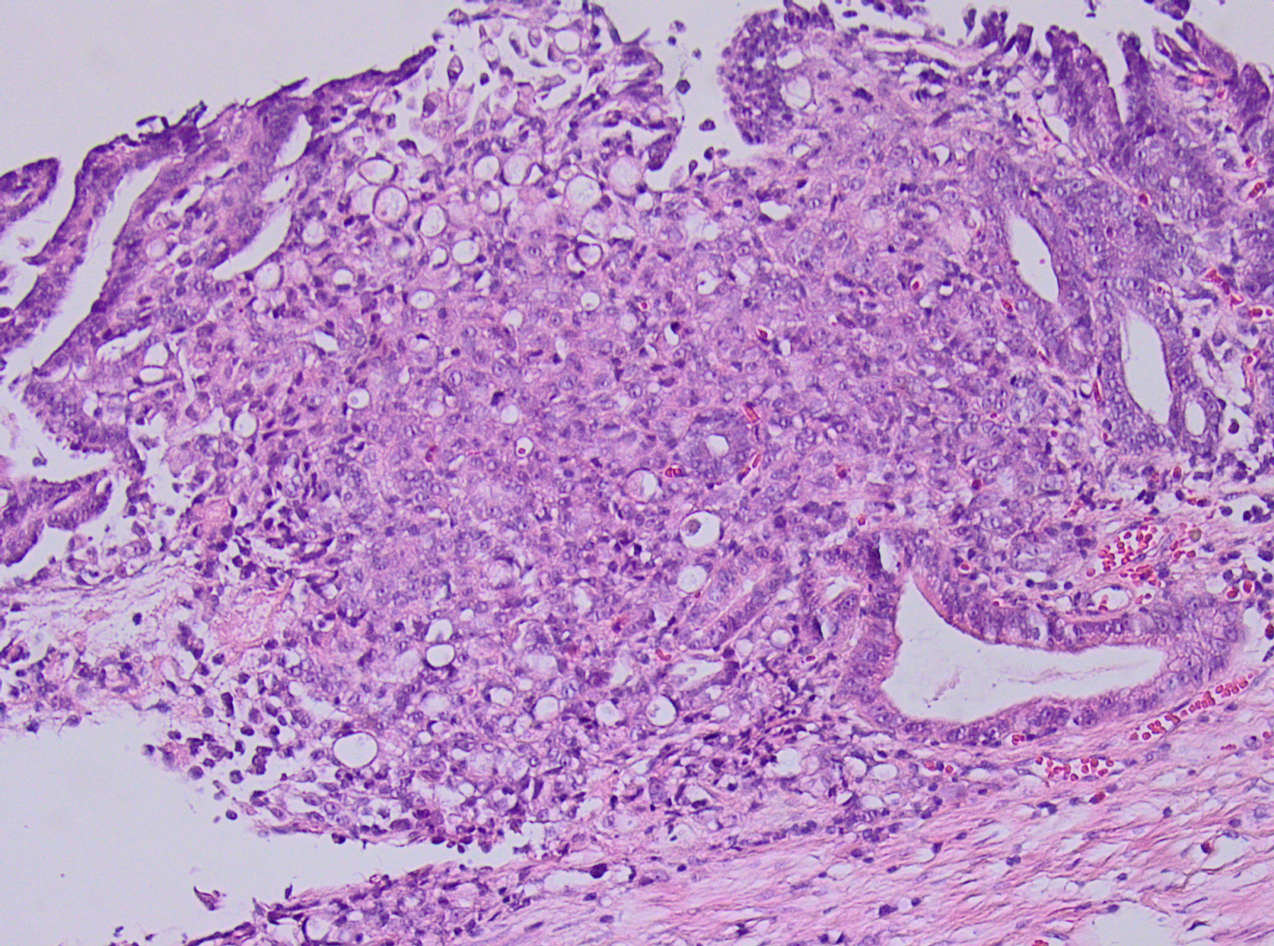
Risk factor: poor differentiation

Slide 37
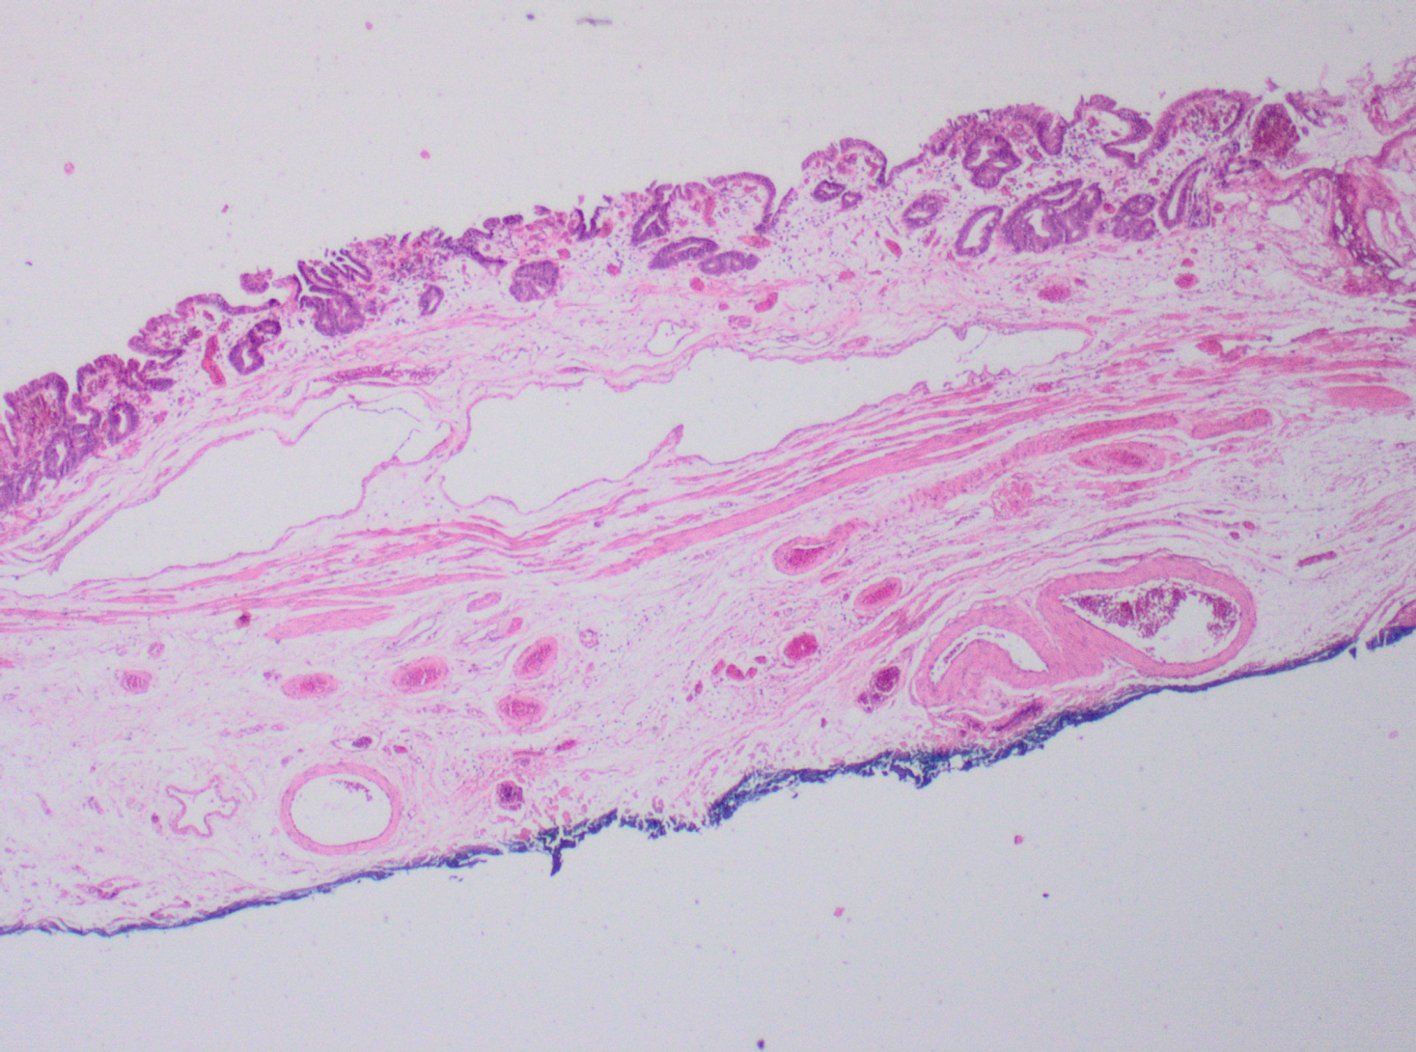
Risk factor: Vaso invasive growth

Slide 38
Vaso invasive growth

Slide 39
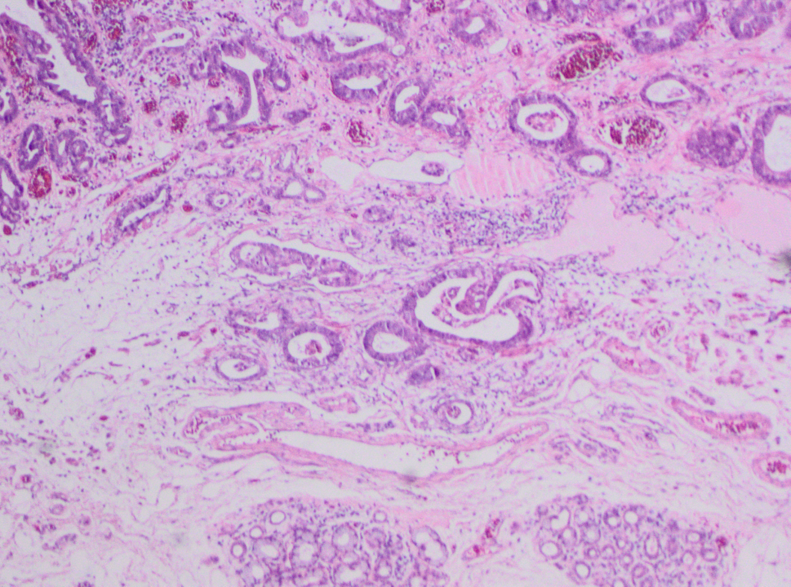
Vaso invasive growth

Slide 40

Vaso invasive growth mimic in squamous lesions

Slide 41

Extension in esophageal duct
(CD-31 IHC)

Slide 42
Risk factors
Positive basal resection margin
Invasion in submucosa
Poorly differentiation grade (solid tumor, signet cell carcinoma)
Vaso invasive growth
Desmin stain
P53
D2-40; CD31

Slide 43
Summary EMRs
Prevent non-interpretable slide
Gross: train resident (& staff)
Parallel slices at regular interval (2-3 mm)
Not too many slices per block
Train lab technician in cutting slides

Slide 44
Summary EMRs
Analyse for risc factors: radicality / poor differentiation / submucosal invasion / vaso invasive growth
Describe and measure the infiltration depth
Usual lateral margin not important

Slide 45
Summary EMRs
Use full stains: desmin and p53
Don’t overestimate depth of invasion at the edge of specimen(desmin stain)
Don’t overestimate non-radical excision needle artefact

Slide 46

Conclusion
Pathology
Team effort
Gastroenterology

