Slide 1
Interpretation of esophageal biopsies and EMR specimens
S.L. Meijer
Academic Medical Center, Amsterdam

Slide 2
Goal: pathology report with one of the defined Vienna categories for neoplasia
Negative
Low-grade dysplasia
High-grade dysplasia
Carcinoma
Indefinite for dysplasia

Slide 3
Main features to be analyzed
Surface maturation in comparison with the underlying glands
Architecture of the glands on the biopsy
Cytologic features of the proliferating cells
Background, inflammation and erosions/ulcers
Notes:
to come to this diagnosis usually these four features are analysed

Slide 4
What is the diagnosis?

Slide 5
Negative for dysplasia

Slide 6
What is the diagnosis?

Slide 7
Low-grade dysplasia
Loss of surface maturation, abnormal architecture
pseudo stratification of enlarged nuclei on the surface

Slide 8
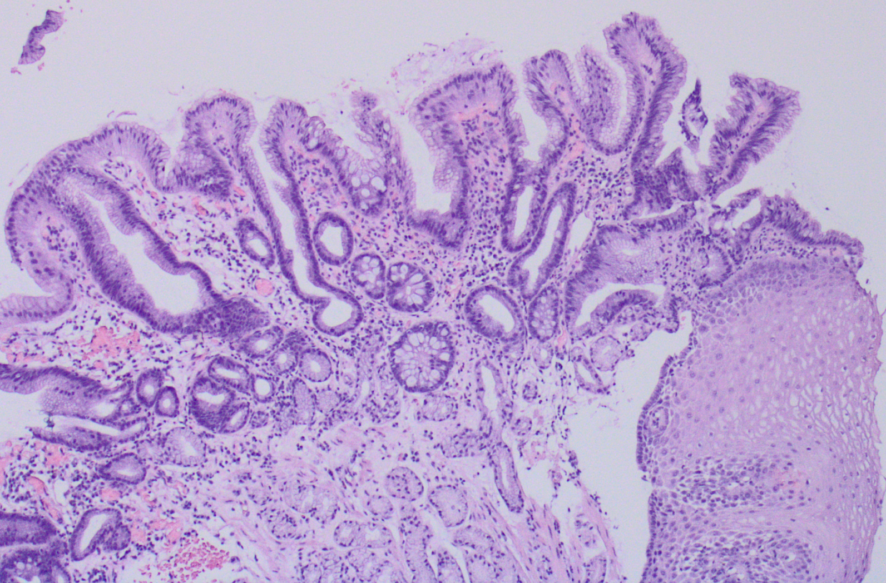
? Diagnosis unclear

Slide 9
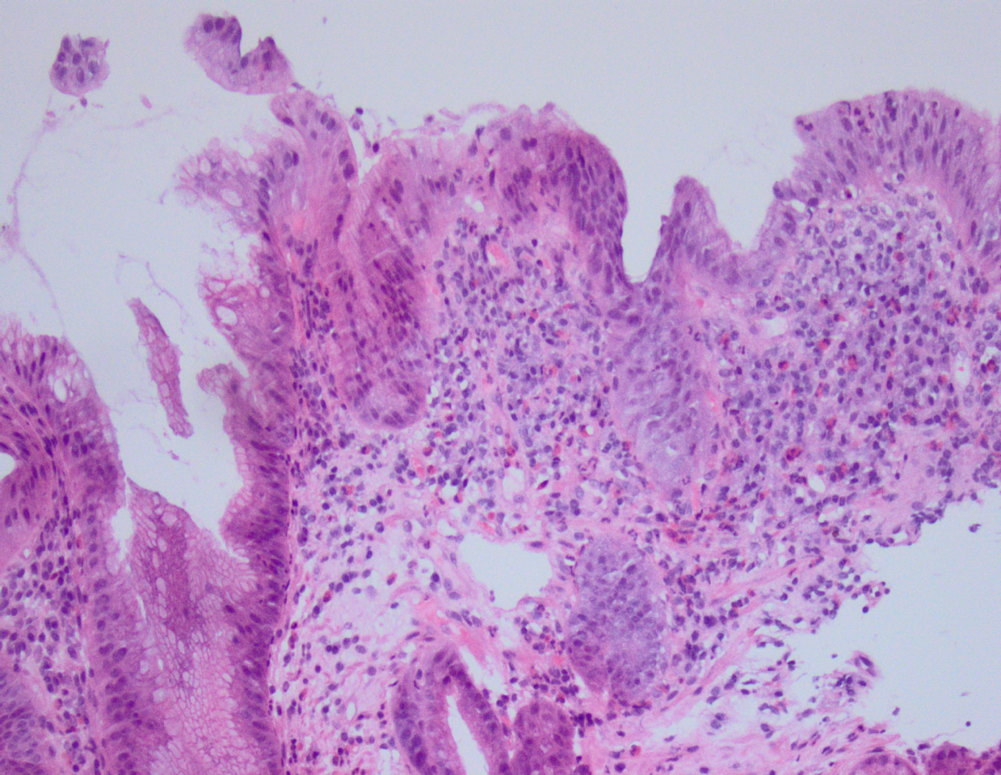
Barrett’s morphogenesis
Chronic injury
Inflammation
Ulceration
Regeneration
Metaplasia

Slide 10
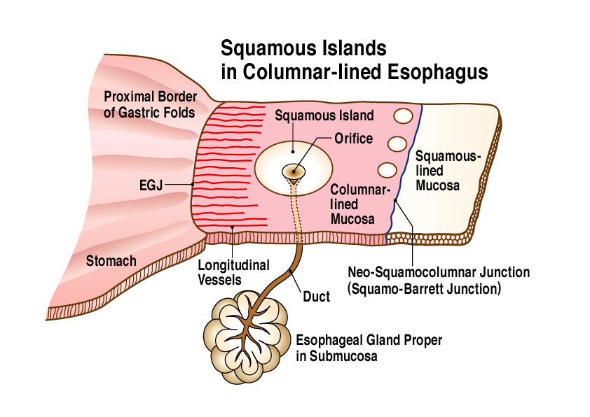
Origin of Barrett’s esophagus?
Different theories:
  Deriving from gastric epithelium / cardiac glands
  Metaplasia of oesophageal stem cells
  Deriving from bone marrow derived stem cells
  Deriving from oesophageal glands

Slide 11
? Diagnosis unclear – be extra careful at the squamo-columnar junction
Intestinal metaplasia
Squamocolumnar junction
Gastric type

Slide 12
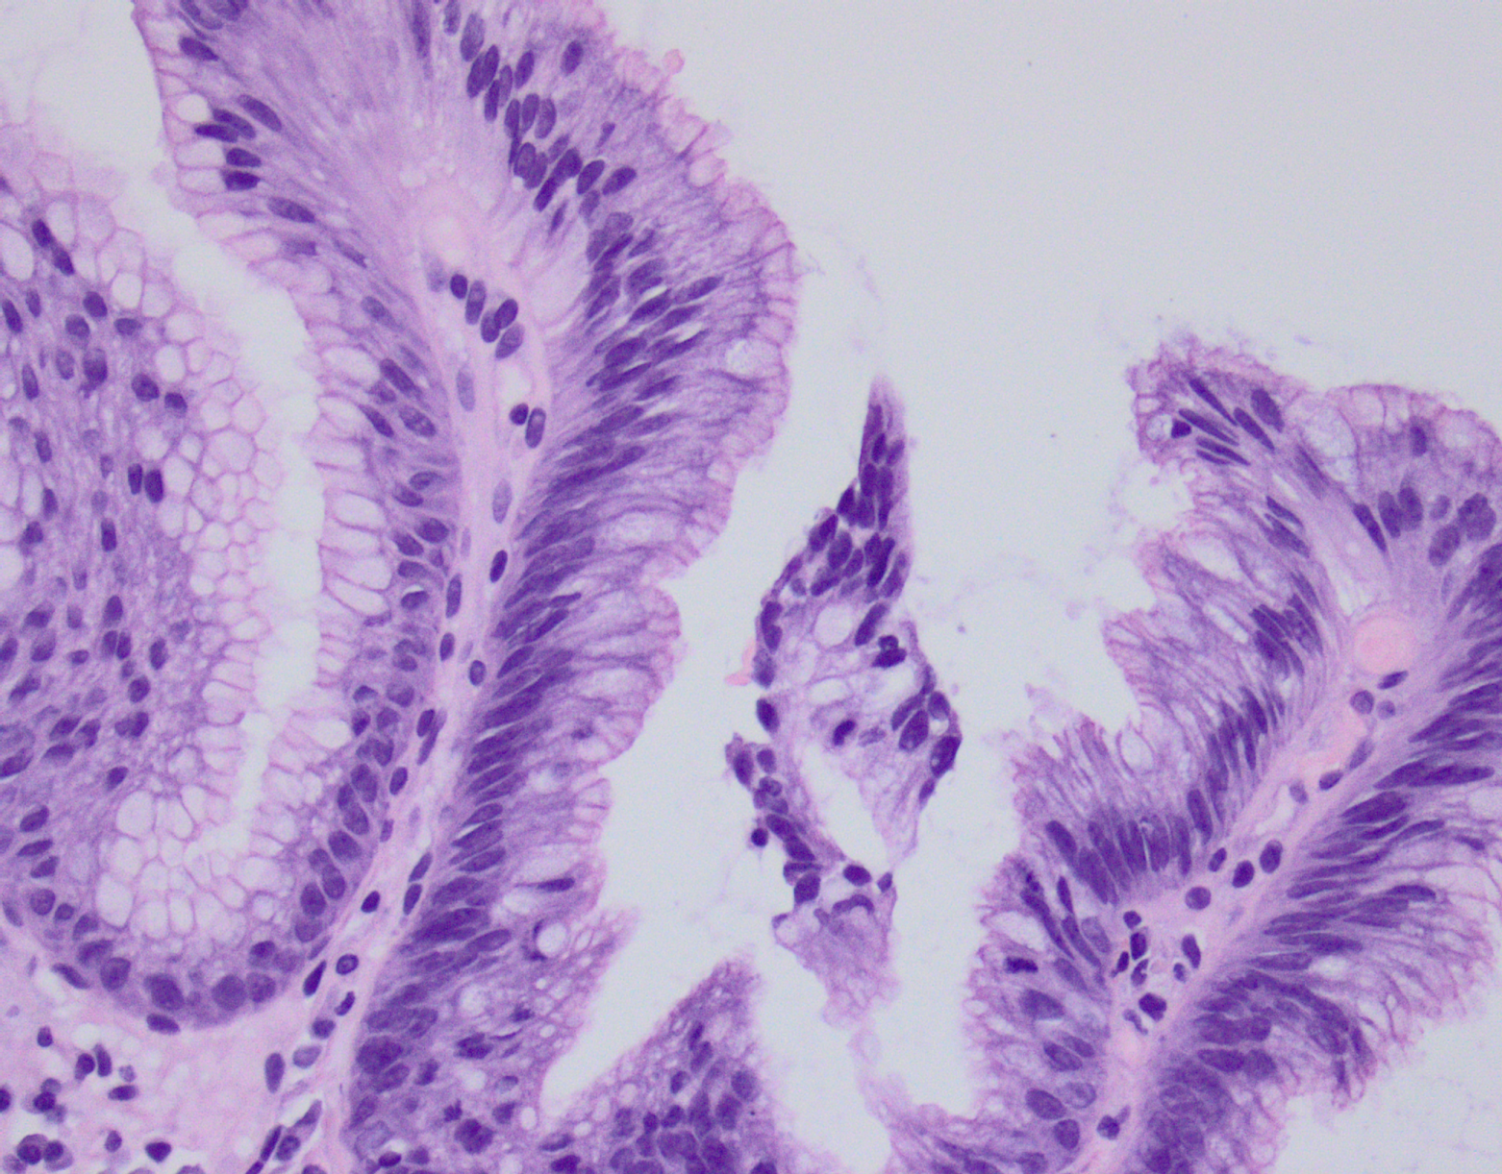
Reactive epithelium – 1 to 2 layers of nuclei (‘4-story epithelium’)

Slide 13
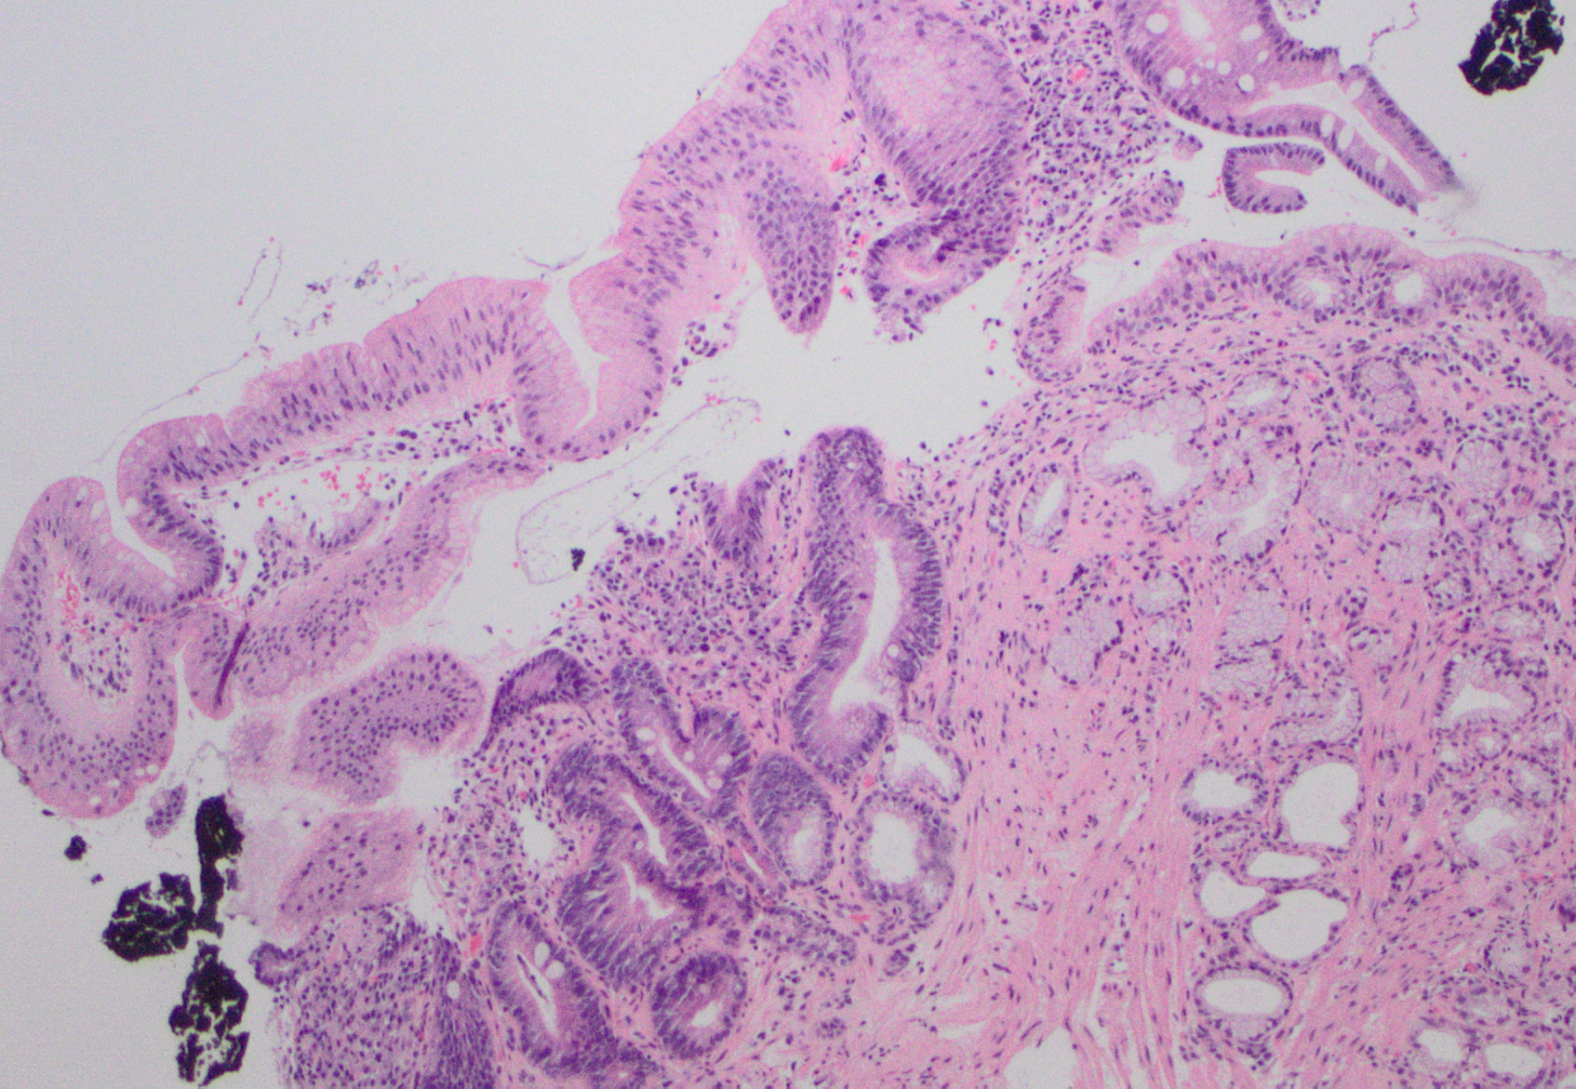
More examples of 4-story epithelium

Slide 14
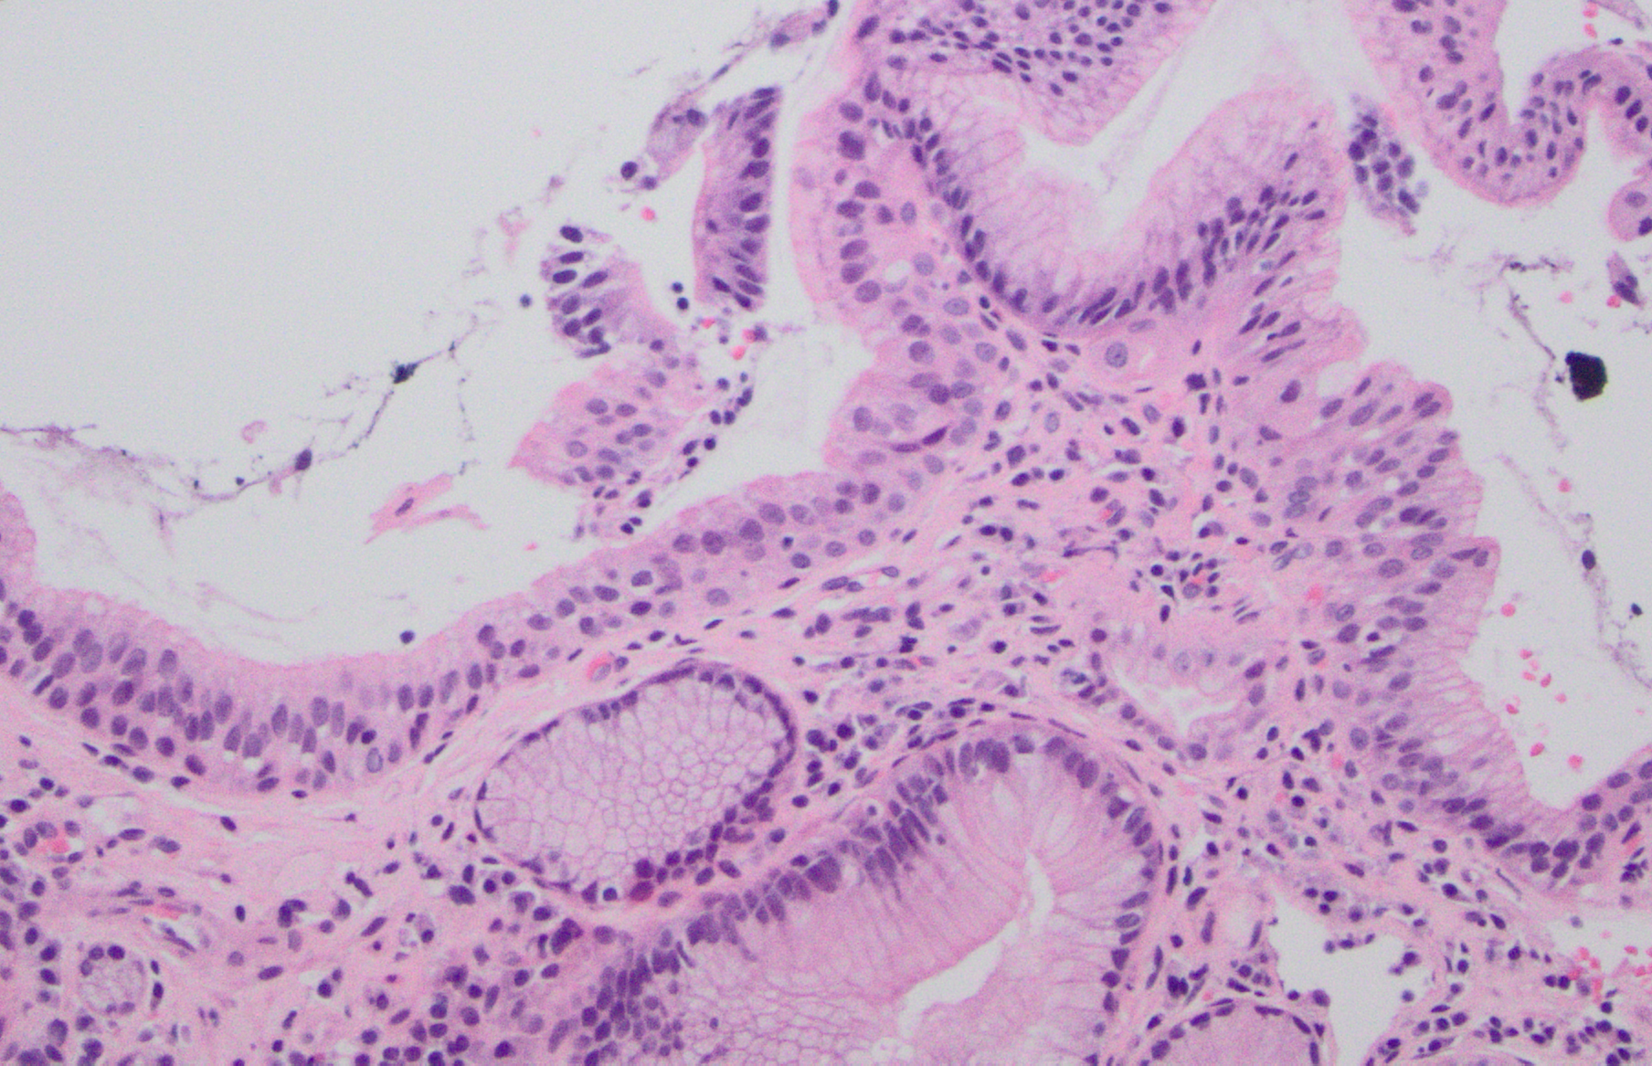
More examples of 4-story epithelium

Slide 15
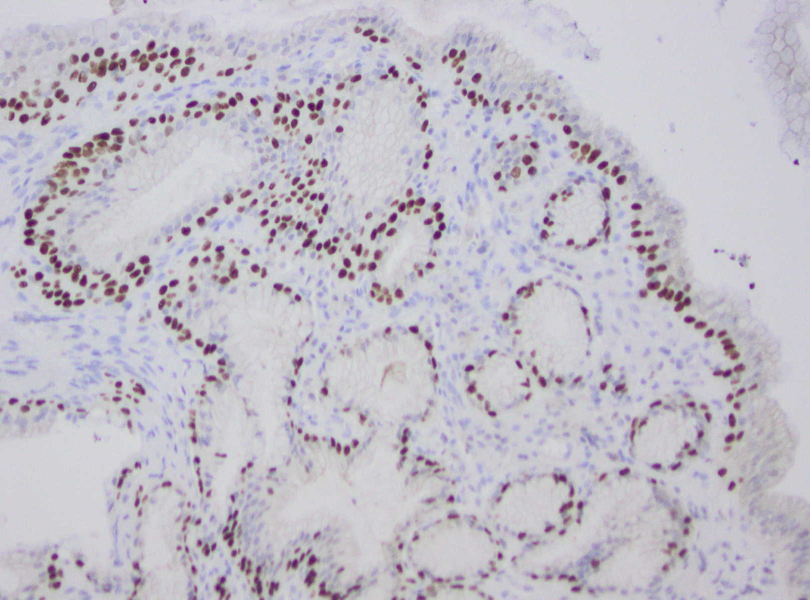
Basal cell hyperplasia (p63 IHC)

Slide 16

Inflammation

Slide 17
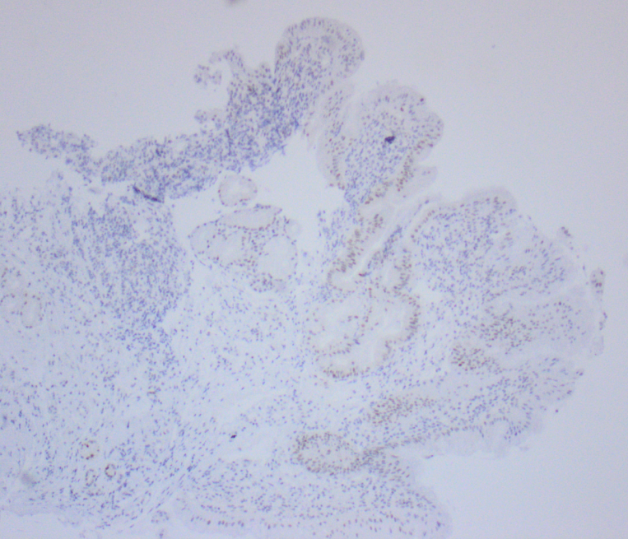
Indefinite for dysplasia? Probably reactive
p53

Slide 18
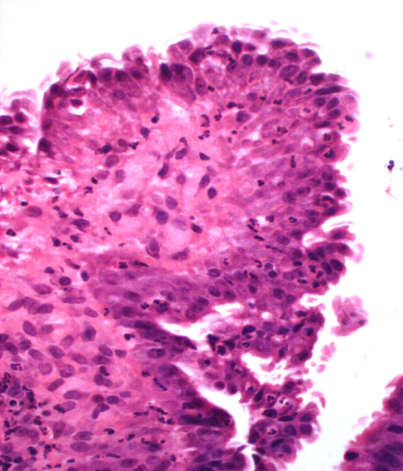
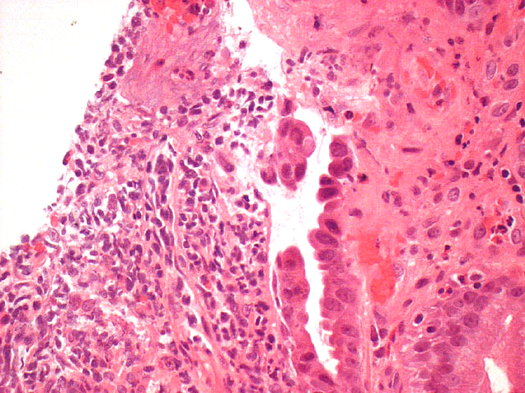
Indefinite for dysplasia
Atypia with inflammation
Reactive versus low-grade dysplasia
Atypia with ulcer
Reactive versus high-grade dysplasia

Slide 19
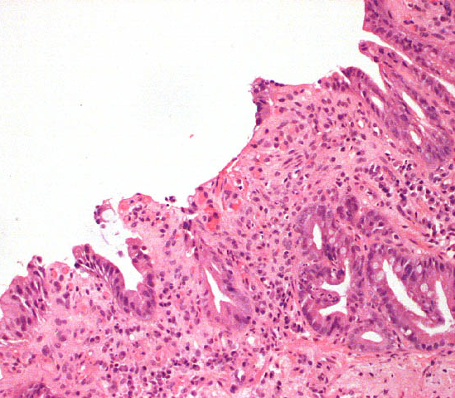
Indefinite for dysplasia
Other reasons for a diagnosis of indefinite for dysplasia:
  Technical issues with biopsy
    fixation artefact
    cutting out
    surface not visible
    poor orientation

Slide 20
Low-grade dysplasia
Maturation
Mitotic index
Pseudostratification
Nuclear to cytoplasmic ratio
Hyperchromatism
Maintained architecture
Sharp demarcation / clonality vs gradual changes

Slide 21
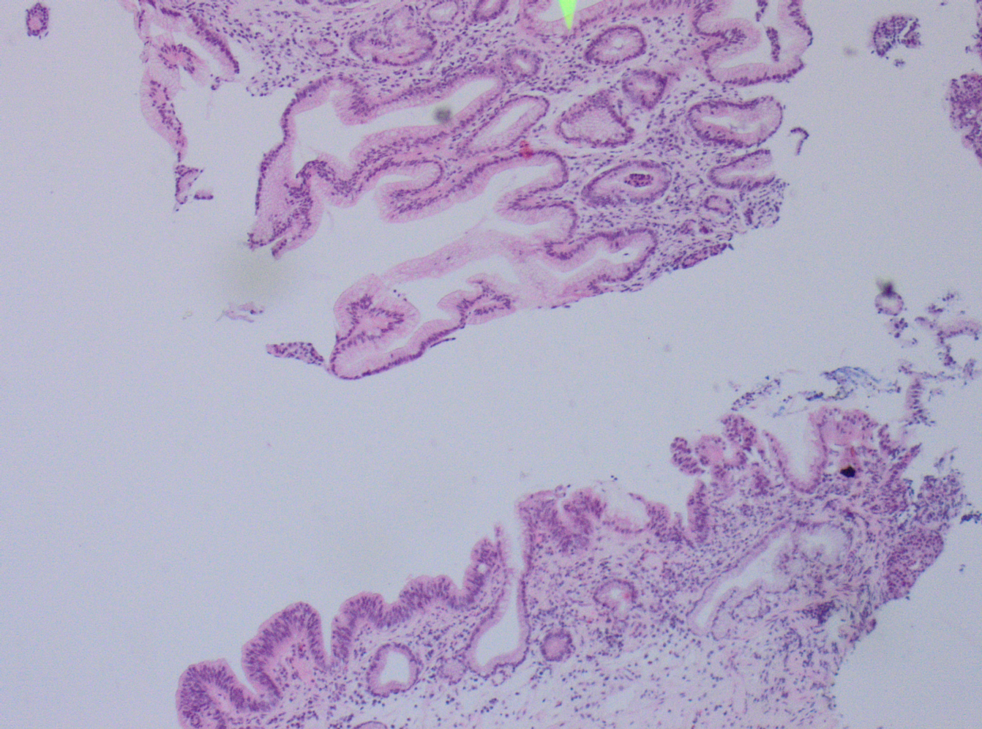
Example

Slide 22
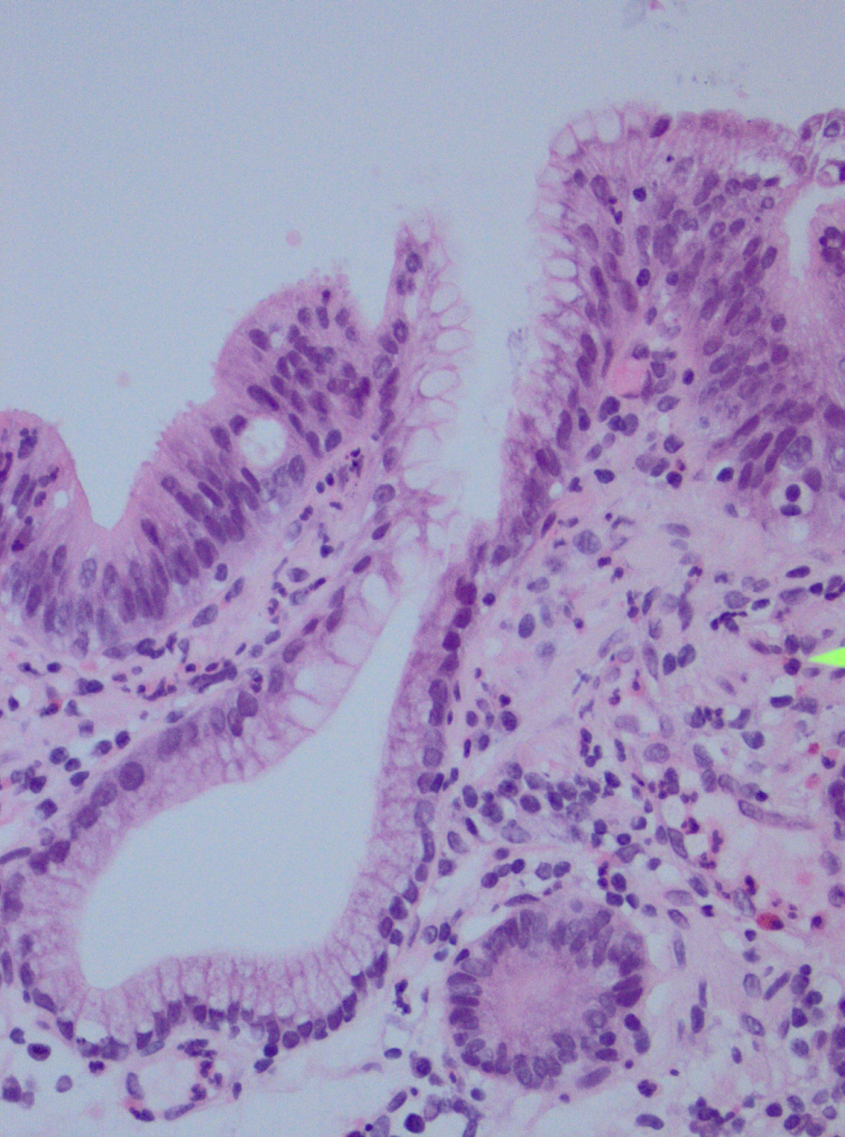
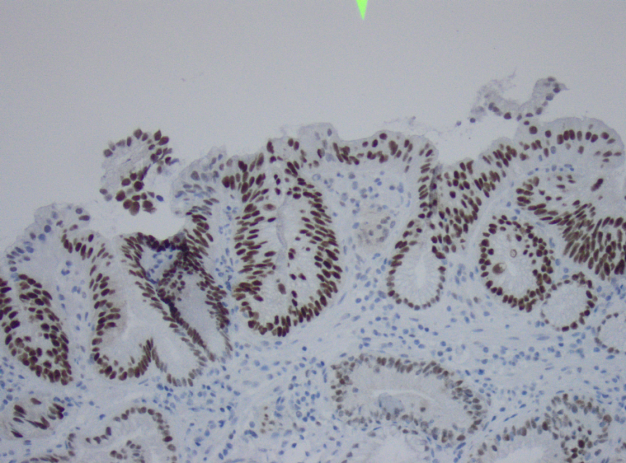
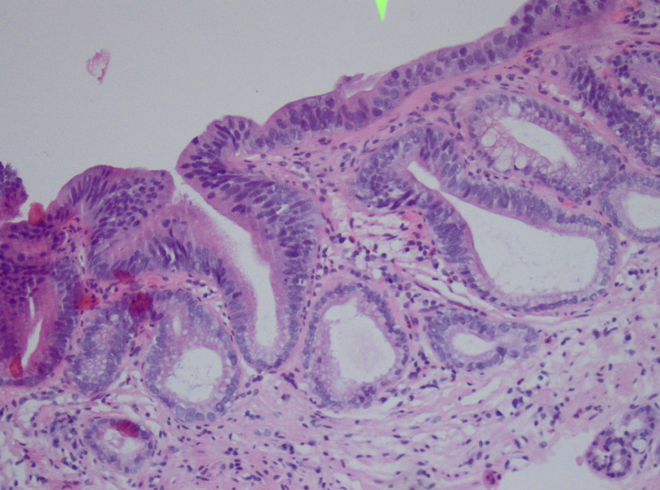
‘Clonality’ in low-grade dysplasia

Slide 23
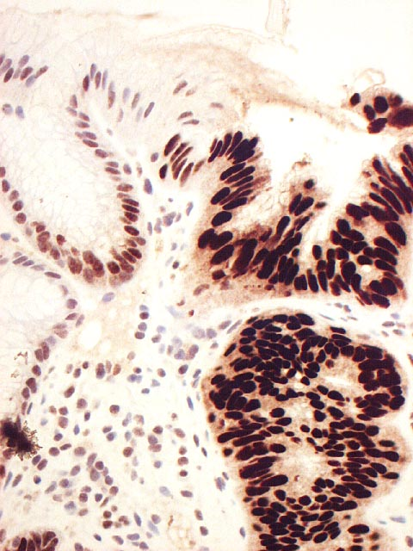
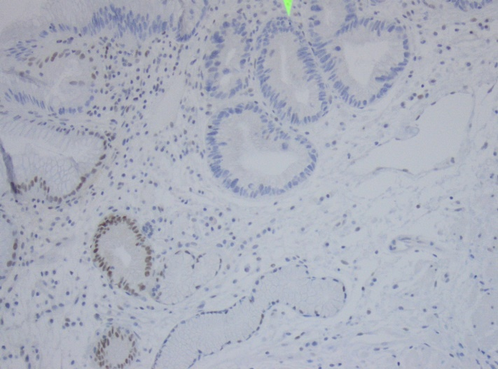
Ancillary studies – p53
Significant staining pattern
  Overexpression (brown color)
  Absent staining pattern (‘null’)
Significant p53 staining in area of interest correlates with likely disease progression
Improves interobserver variability

Slide 24
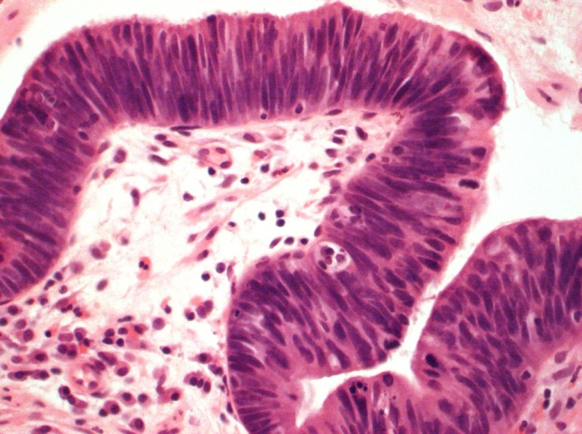
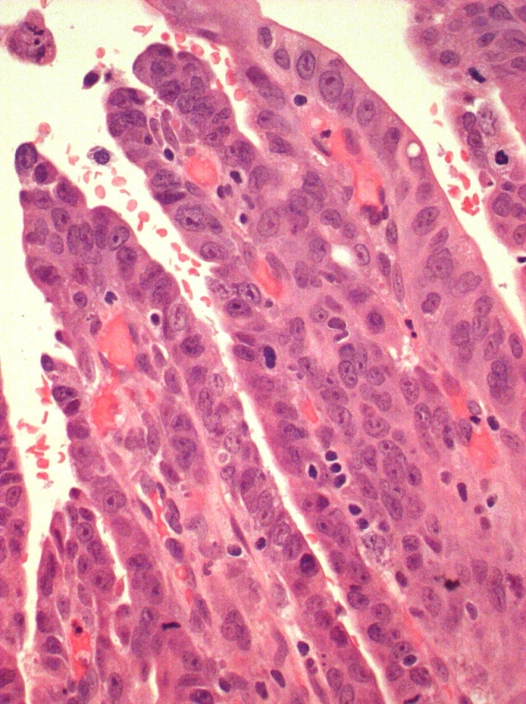
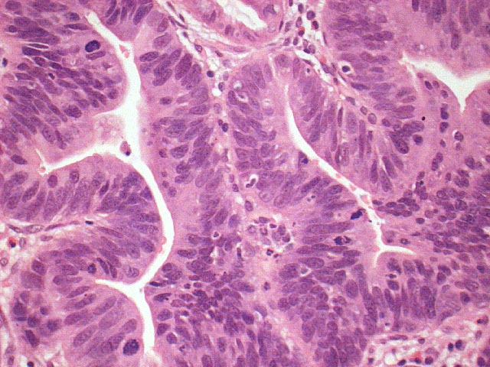
High-grade dysplasia: adenomatous (L) or small-cell type (R)
  mall-cell type

Slide 25
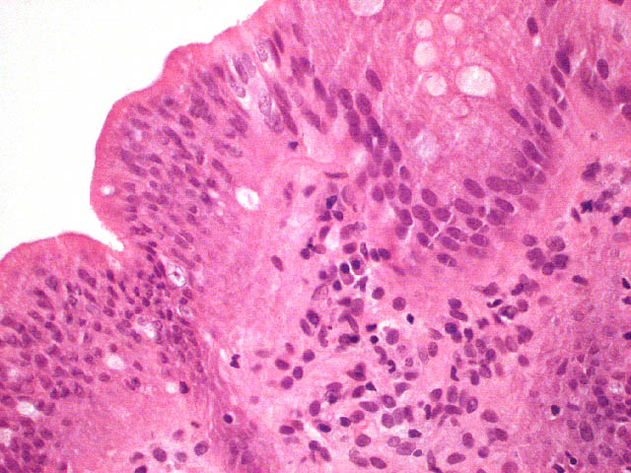
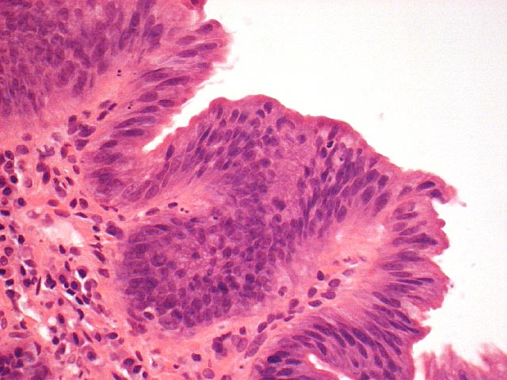
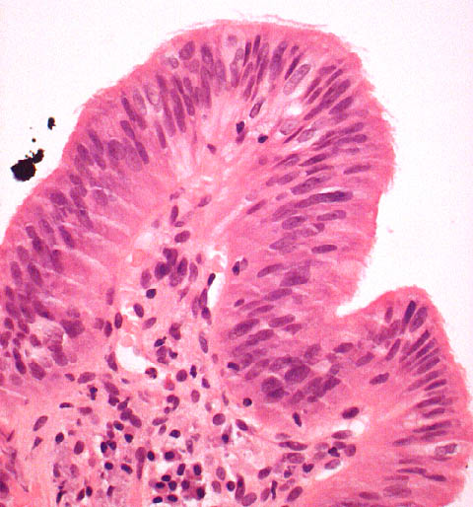
Intra- and inter-observer variability in diagnosis low-grade dysplasia
Negative versus indefinite versus low grade
Consider second opinion, greater the consensus, greater the risk of progression
Montgomery E et al. Human Pathol 2001;32: 368-78
Kaye PV et al. Histopathology 2009;54:699-712

Slide 26
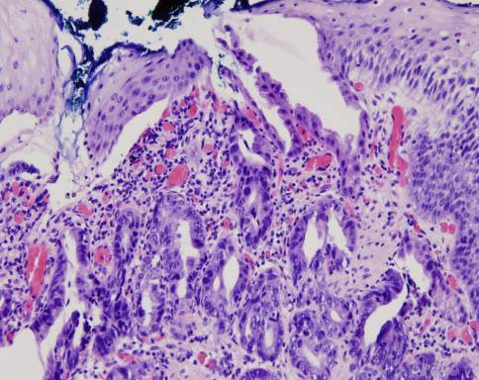
High-grade dysplasia
Irregular branching glands
Expansion up to surface
Loss of epithelial maturation
Enlarged nuclei
Hyperchromatic nuclei
Nucleoli

Slide 27
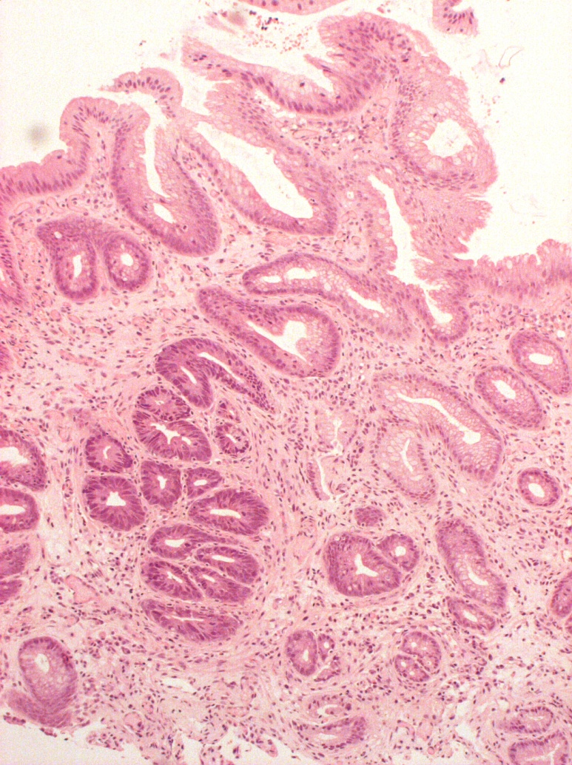
Basal crypt dysplasia
Dysplasia in deep glands, not reaching surface
Grade?
Usually managed as low-grade dysplasia

Slide 28
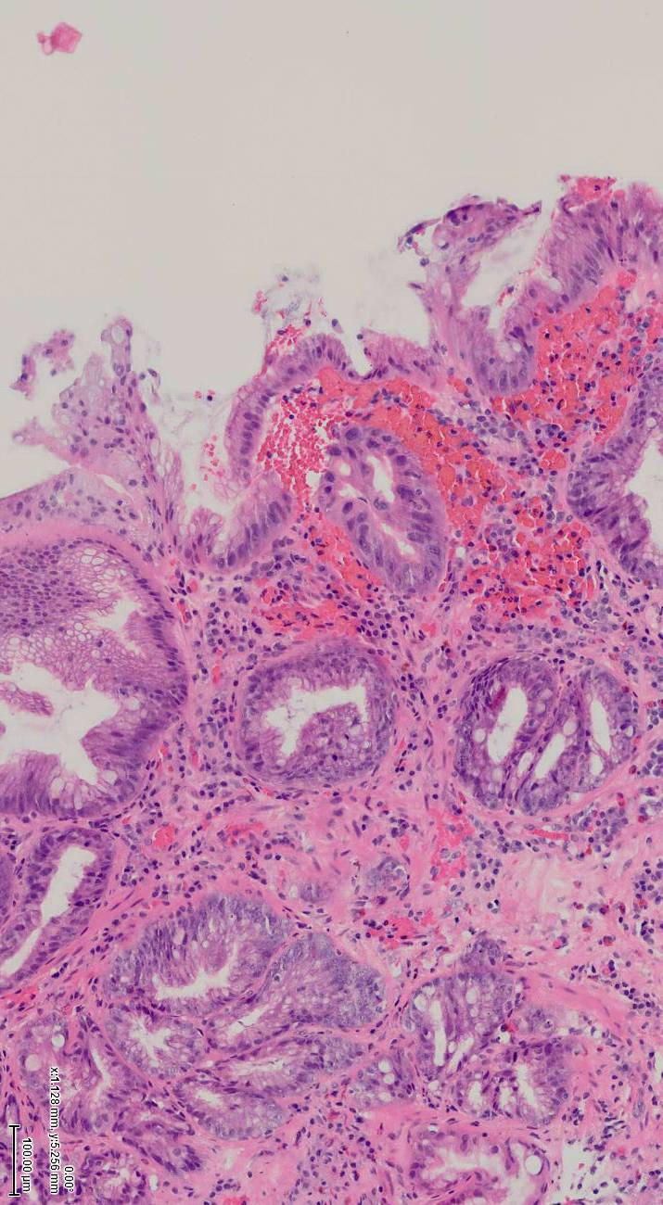
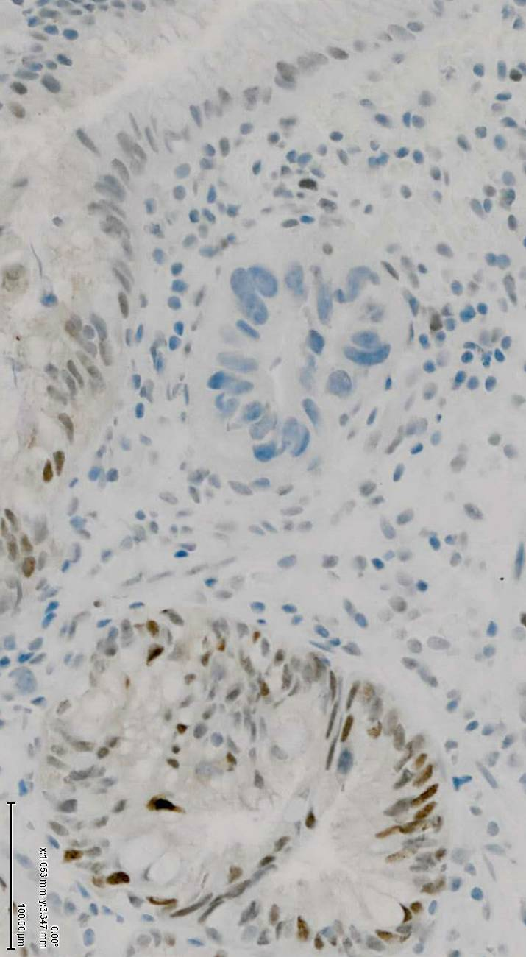
Example

Slide 29
Conclusion
Morphology is the gold standard but dysplasia diagnosis remains problematic
  Inflammation and regeneration
  Lack of widely accepted biomarkers
  Intra & interobserver variability
Look for abrupt changes vs gradual changes
Consider second opinion, greater the consensus, greater the risk of progression

