Slide 1
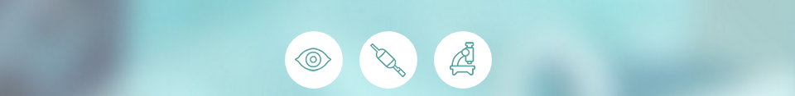
How to perform a Barrett’s surveillance endoscopy
A standardized Barrett’s surveillance endoscopy in 6 steps

Slide 2

Background on BE
Esophageal adenocarcinoma (EAC) is the cancer with the fastest rising incidence in Western world
Barrett’s esophagus is a known precursor of EAC
Endoscopic detection of early Barrett’s neoplasia is important, since endoscopic treatment has an excellent prognosis
However, current surveillance protocols are not optimal:
  Subtle appearance of early neoplasia
  Sampling error of random biopsies

Slide 3
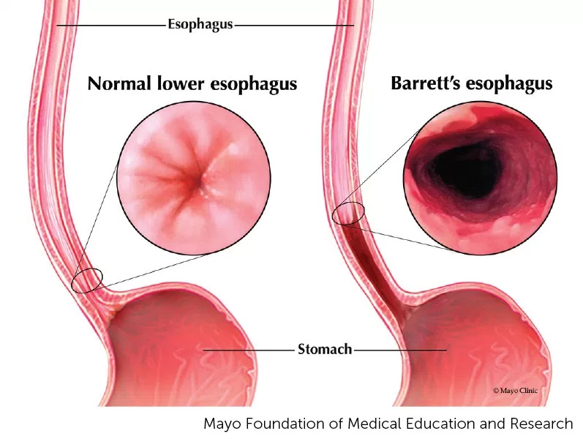
Background on BE

Slide 4
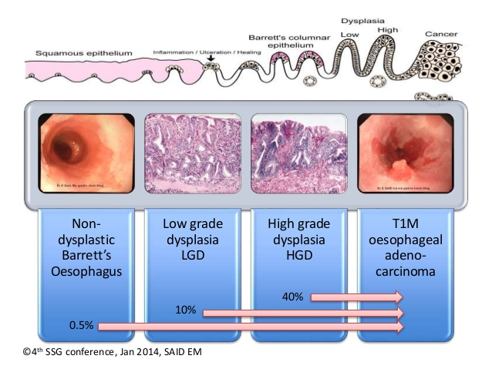
Background on BE

Slide 5
6 steps of standardized BE endoscopy
Take the best endoscope you have;
Clean the esophagus thoroughly before inspection;
Know where to look;
Know what to look for;
Document Prague Classification and lesion type (Paris-classification);
Adhere to the Seattle biopsy protocol.

Slide 6
6 steps of standardized BE endoscopy
Take the best endoscope you have;
Clean the esophagus thoroughly before inspection;
Know where to look;
Know what to look for;
Document Prague Classification and lesion type (Paris-classification);
Adhere to the Seattle biopsy protocol.

Slide 7
Take the best endoscope you have
Perform surveillance with HD-WLE: all leading companies now provide you with HD-WLE and high quality optical chromoscopy
State-of-the art endoscopic equipment allows most lesions to be seen in HD-WLE
Incremental value of advanced imaging is becoming smaller and smaller
  4K-HDTV and 3-D endoscopy lie ahead

Slide 8
Optical chromoscopy techniques
Pre-processing techniques: NBI (Olympus), BLI (Fujifilm), OE (Pentax)
  Blue light excitation: only penetrates superficially into the tissue, less scattering
  Blue light is absorbed by haemoglobin
  Better visualization of mucosal and vascular structures
Post-processing techniques: FICE (Fujifilm) or I-scan (Pentax)
  Normal white light excitation with reprocessing of the reflected image
  Better visualization of mucosal and vascular structures
  More "noisy" image

Slide 9
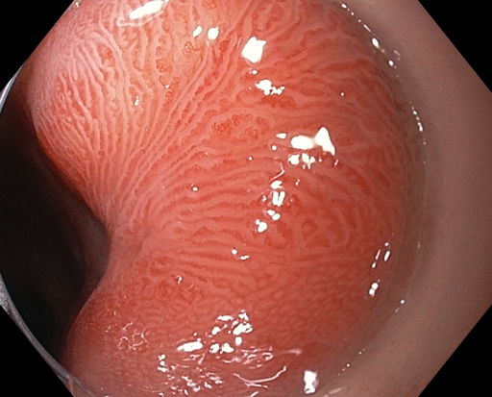
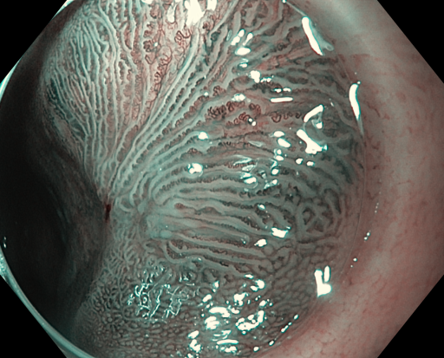
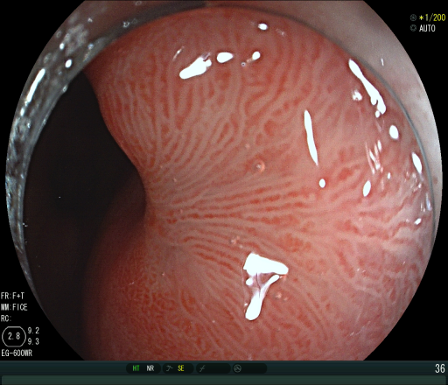
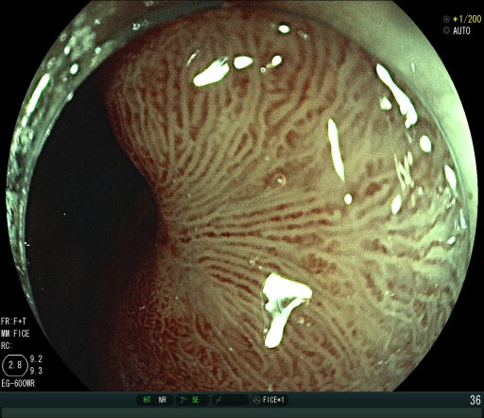
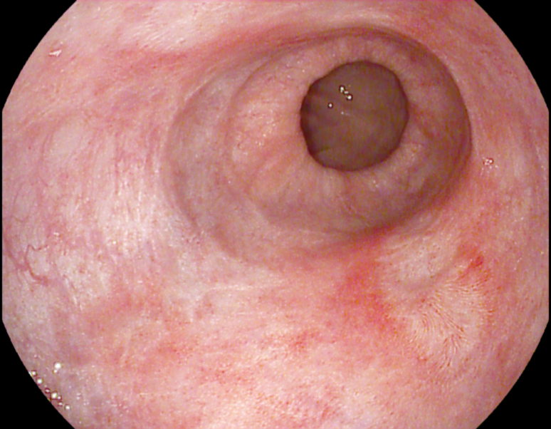
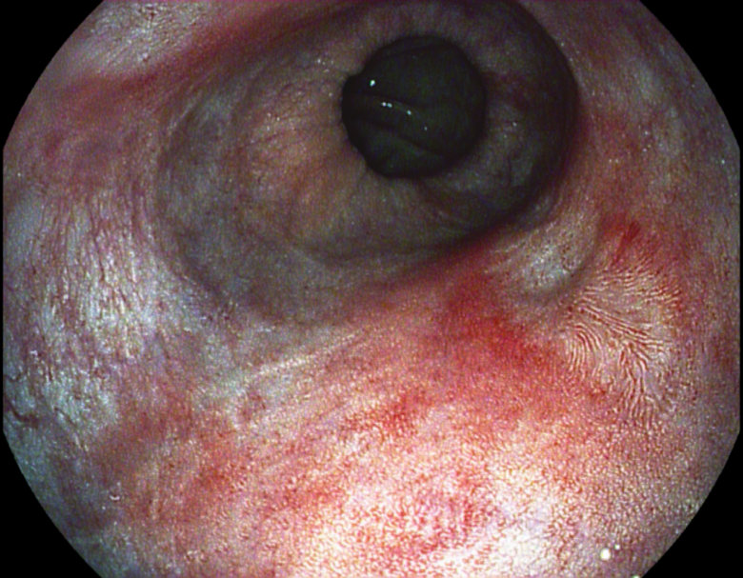
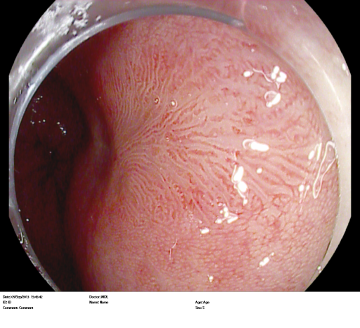
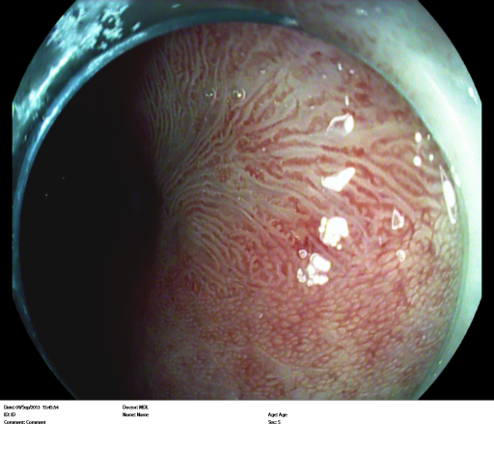
Optical chromoscopy techniques
BLI
NBI
FICE
I-scan

Slide 10
Optical chromoscopy for detection?
• Studies comparing NBI/FICE/I-scan with chromoscopy have shown similar neoplasia detection rates
Note: studies are underpowered to demonstrate equality
• Most early neoplastic lesions in BE can be seen with HD-WLE
• Additional value of NBI/BLI/FICE/I-scan as a detection tool in overview therefore appears to be limited

Slide 11
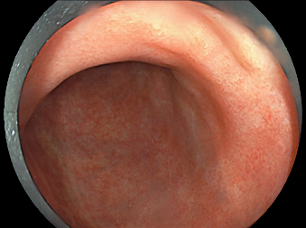
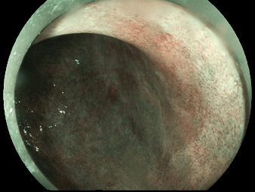
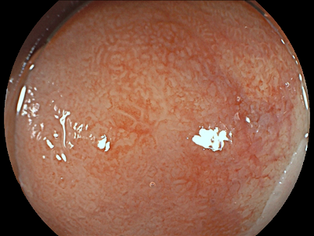
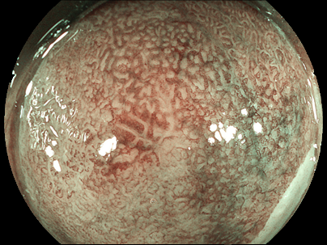
Optical chromoscopy for delineation?
With WLE, visible lesions often lack a clear demarcation line, separating neoplasia from its surrounding normal mucosa
Optical chromoscopy provides a better characterization of the demarcation line and is therefore preferred for delineating lesions

Slide 12
6 steps of standardized BE endoscopy
Take the best endoscope you have;
Clean the esophagus thoroughly before inspection;
Know where to look;
Know what to look for;
Document Prague Classification and lesion type (Paris-classification);
Adhere to the Seattle biopsy protocol.

Slide 13
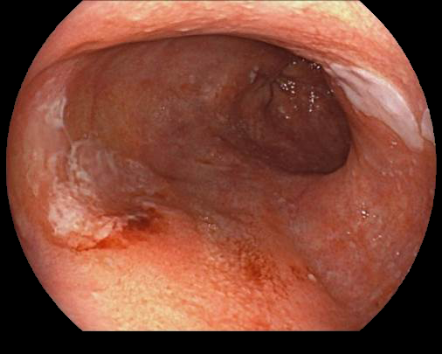
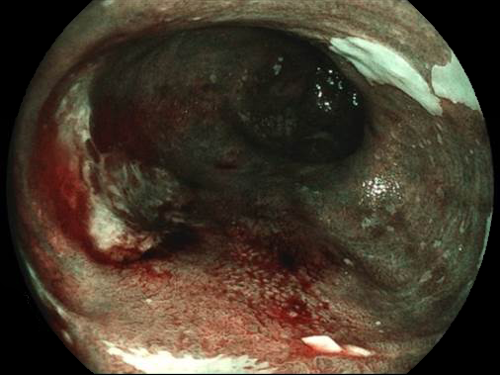

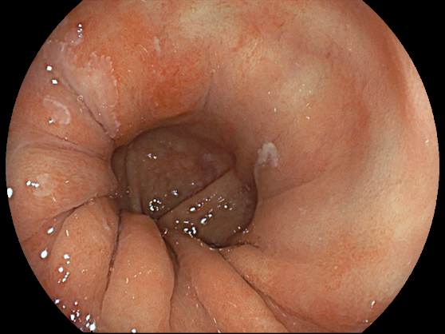
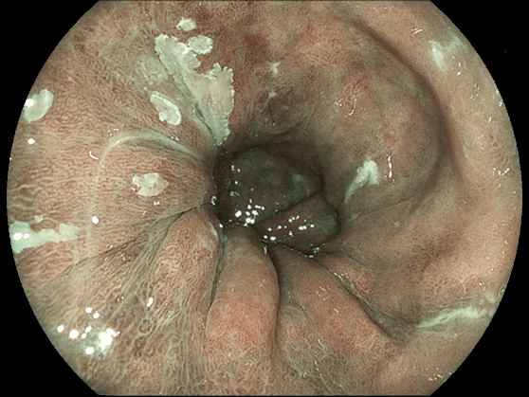
Clean the esophagus before inspection

Slide 14
6 steps of standardized BE endoscopy
Take the best endoscope you have;
Clean the esophagus thoroughly before inspection;
Know where to look;
Know what to look for;
Document Prague Classification and lesion type (Paris-classification);
Adhere to the Seattle biopsy protocol.

Slide 15
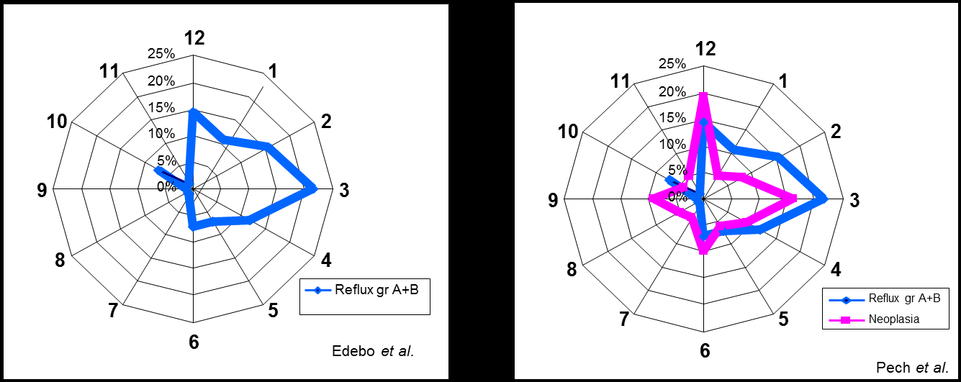
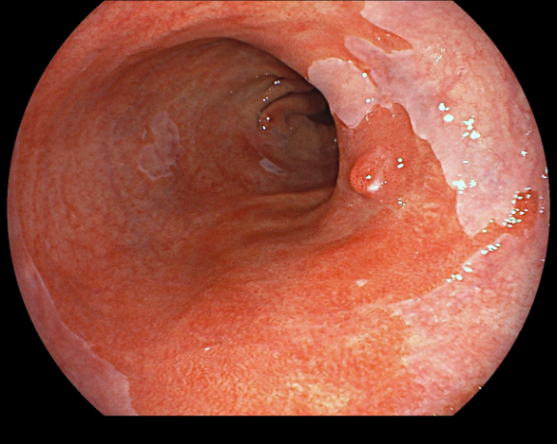
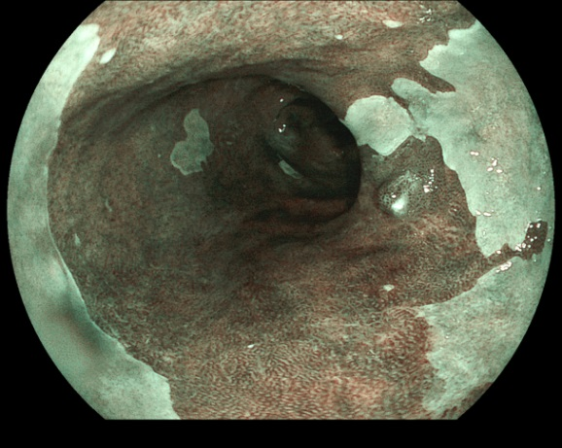
Know where to look
Early Barrett’s lesions are more frequently located at the right side of your screen

Slide 16
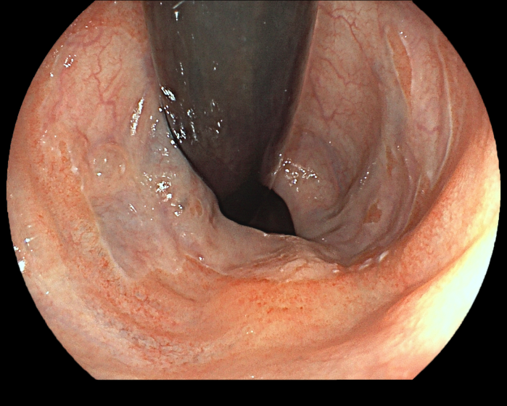
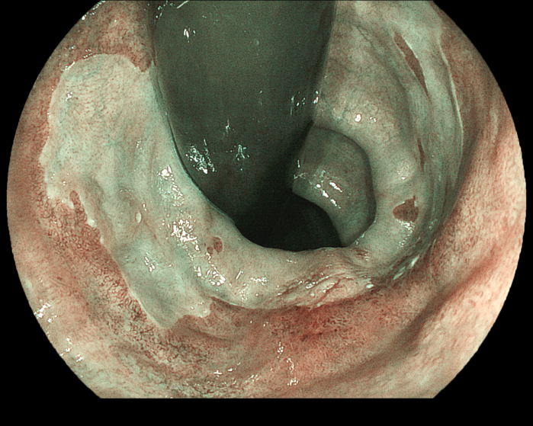
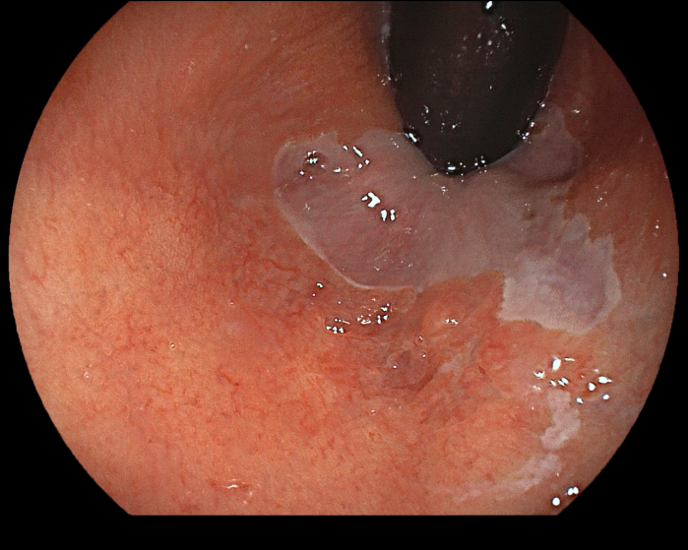
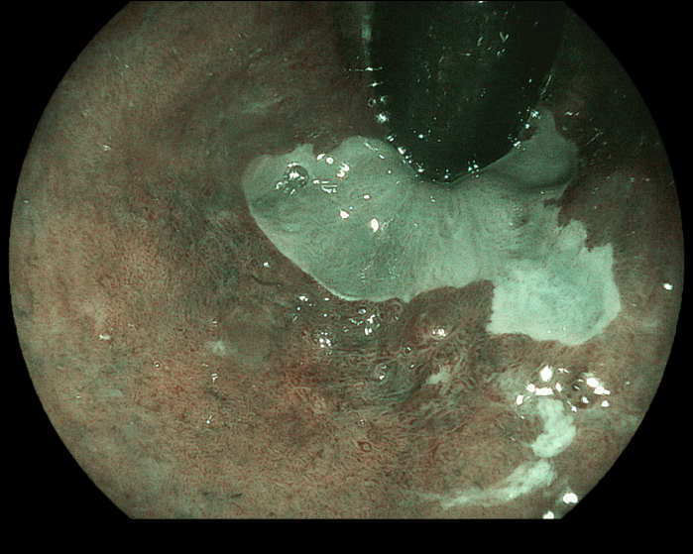
Know where to look
Focus on the "danger zone": Retroflex!

Slide 17
A standardized BE surveillance endoscopy in 6 steps
Take the best endoscope you have;
Clean the esophagus thoroughly before inspection;
Know where to look;
Know what to look for;
Document Prague Classification and lesion type (Paris-classification);
Adhere to the Seattle biopsy protocol.

Slide 18
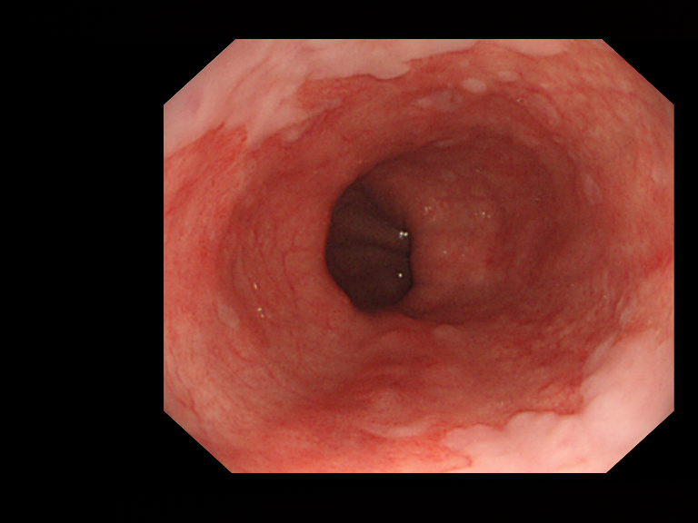
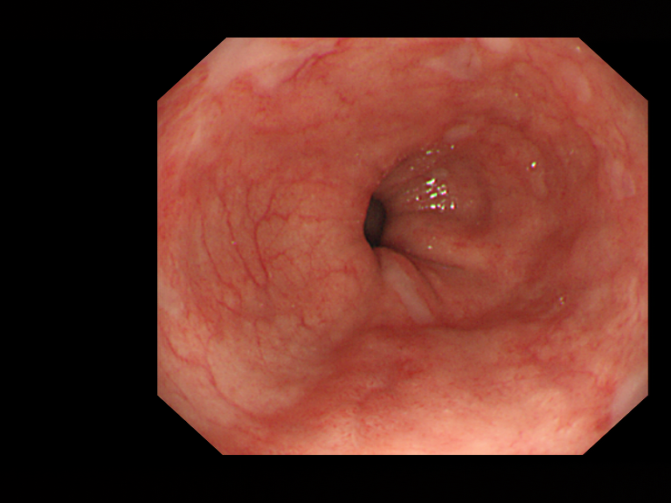
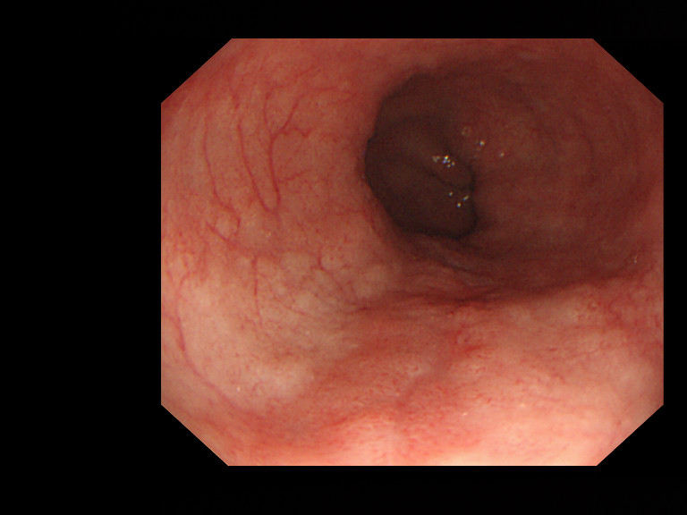
Know what to look for
Early neoplasia is often subtle
Most Barrett’s lesions are small (<1cm²) and flat; Polypoid lesions are rare
State-of-the art endoscopic equipment allows most lesions to be seen. However…..
→ You do not detect what you see: you detect what you recognize

Slide 19
6 steps of standardized BE endoscopy
Take the best endoscope you have;
Clean the esophagus thoroughly before inspection;
Know where to look;
Know what to look for;
Document Prague Classification and lesion type (Paris-classification);
Adhere to the Seattle biopsy protocol.

Slide 20
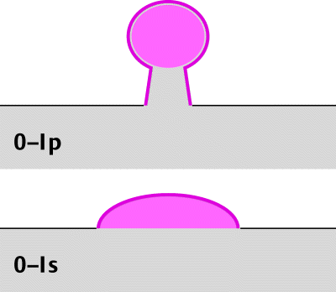
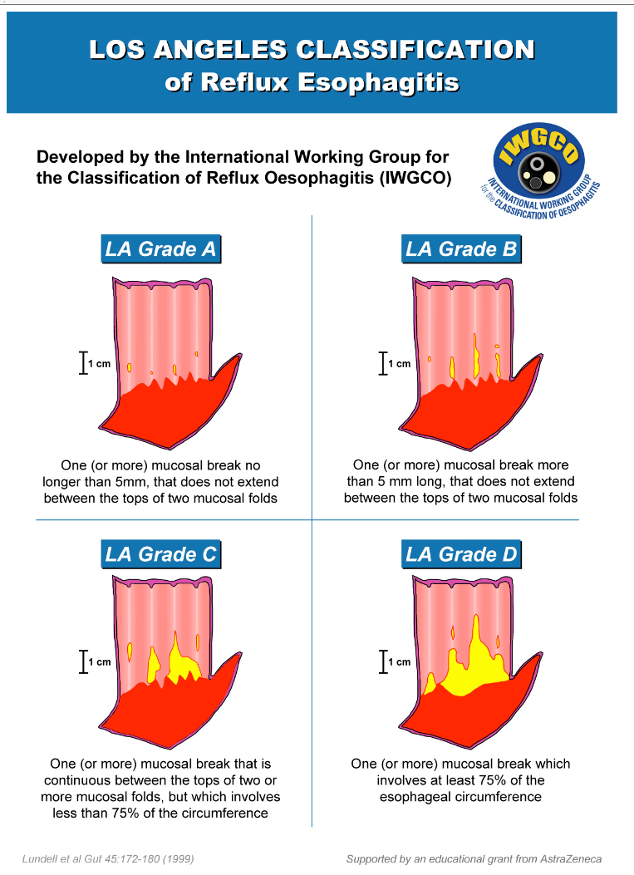
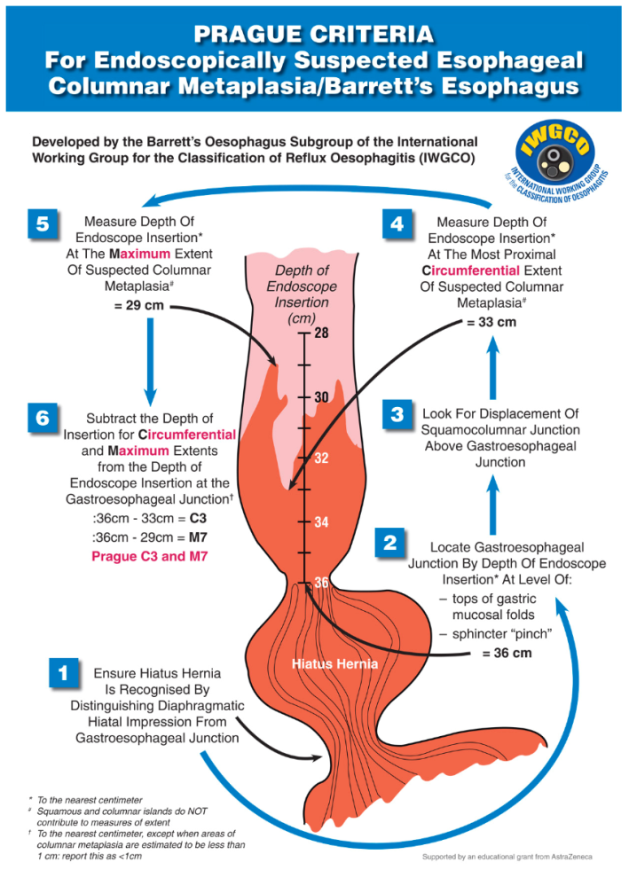
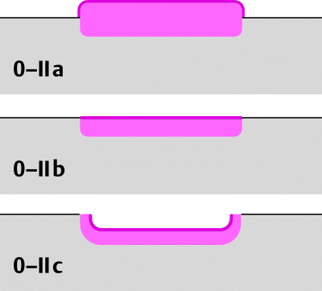

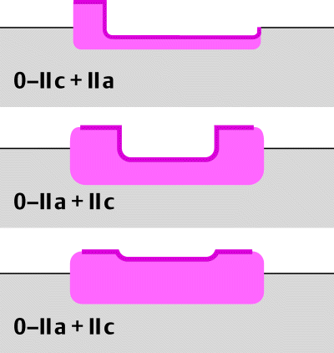
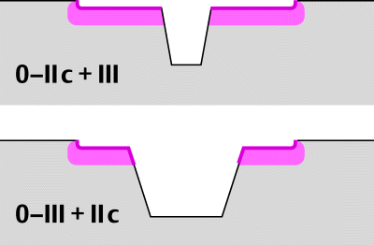
Document LA classification, Prague Classification and lesion type (Paris classification)
Lundell et al. Gut 45:172-180 (1999)
Sharma et al. Gastroenterology 131:1392-9 (2006)
Endoscopic Classification Review Group. Endoscopy 37:570-8 (2005)

Slide 21
6 steps of standardized BE endoscopy
Take the best endoscope you have;
Clean the esophagus thoroughly before inspection;
Know where to look;
Know what to look for;
Document Prague Classification and lesion type (Paris-classification);
Adhere to the Seattle biopsy protocol.

Slide 22
6 steps of standardized BE endoscopy
Take the best endoscope you have;
Clean the esophagus thoroughly before inspection;
Know where to look;
Know what to look for;
Document Prague Classification and lesion type (Paris-classification);
Adhere to the Seattle biopsy protocol.
Targeted biopsies of visible lesions and random four quadrant biopsies every 2 cm of BE segment

Slide 23
6 steps of standardized BE endoscopy
Take the best endoscope you have;
Clean the esophagus thoroughly before inspection;
Know where to look;
Know what to look for;
Document Prague Classification and lesion type (Paris-classification);
Adhere to the Seattle biopsy protocol.

